Slide 1
Approach to build preference and loyalty for Ola among customers

Slide 2
Executive summary
To be filled at the end

Slide 3
Content
Definition of preference and loyalty of customers
Objectives of customer loyalty
Factors that influence preference & loyalty
Segmentation: Based on customer X context
Building preference among Segment 1
Building preference among Segment 2
Building preference among Segment 3 & 4
Building preference among Segment 5 & 6

Slide 4
Definition of preference and loyalty of customers

Slide 5
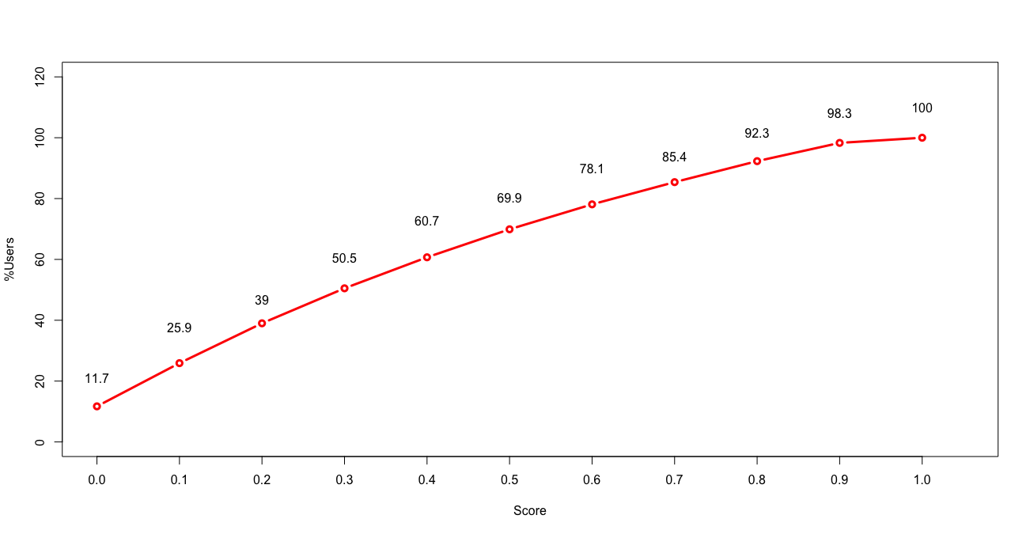
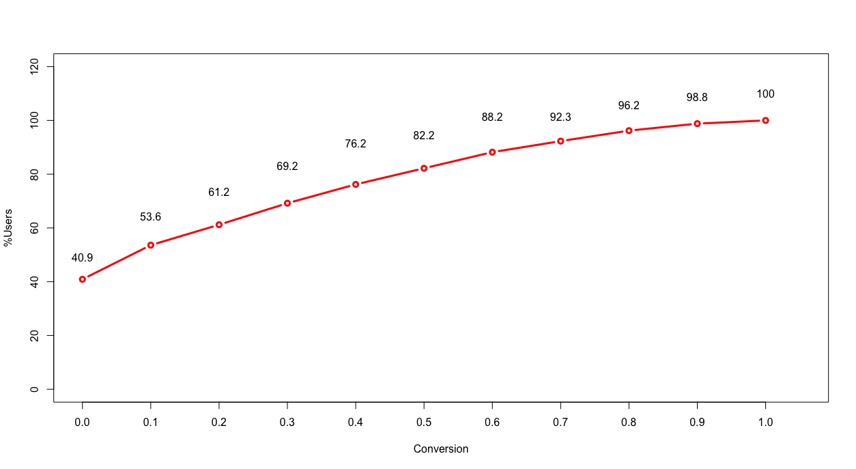
Definition of preference and loyalty of customers
What kind of customer behaviour indicates preference for Ola -
A customer who gives a significantly high share of wallet
A customer who does not window shop
Mathematically, that translates to
Share of Wallet (SOW) - Current LTV/ Potential LTV (in last 6 months)
Conversion - Ratio of ride now to Booking confirmed (in last 6 months)
A customer who exhibits this behaviour consistently over time, can be said to be loyal to Ola
Note: Customers with rides > 10 & GMV > 2000 in last 6 months have been considered for tagging
%Users
SOW Score
%Users
Conversion
There is no inflection point in SOW & conversion distribution : 75% SOW & 75% conversion threshold

Slide 6
There is significant overlap of customers who give Ola >75% SoW and conversion of >75%
 | Count of users |  | Avg. Score
%SOW | Preference | No Preference | Preference | No Preference
90% | 101,419 | 2,112,819 | 94% | 40%
80% | 242,528 | 1,971,710 | 89% | 36%
75% | 322,842 | 1,891,396 | 86% | 34%
70% | 401,695 | 1,812,543 | 83% | 32%
60% | 572,661 | 1,641,577 | 78% | 27%
50% | 766,659 | 1,447,579 | 72% | 23%
 |  | Share of Wallet > 75%
 |  | Preference | No preference | Total
Conversion > 75% | Preference | 76,688 | 11,207 | 87,895
 | No preference | 49,375 | 419,913 | 469,288
 | Total | 126,063 | 431,120 | 557,183
89% overlap across the two definitions -- >=75% SOW is the definition of customer preference

Slide 7
Only 4% of our customers have preference for us, giving 14% rides and 15% GMV
Current State - Aug'17
 | MAU | Loyal | Non Loyal | Not Qualified
Users | 8,673,637 | 320,396 | 1,743,627 | 6,609,614
Rides | 30,823,025 | 4,431,107 | 11,698,463 | 14,693,455
GMV | 6,306,815,656 | 962,291,978 | 2,114,368,477 | 3,230,155,201
%Users |  | 4% | 20% | 76%
%Rides |  | 14% | 38% | 48%
%GMV |  | 15% | 34% | 51%
GMV/cust | 727 | 3,003 | 1,213 | 489
BR | 16.2 | 17.1 | 16.0 | 20.5
Rides/cust/month | 3.6 | 13.8 | 6.7 | 2.2
Capacity/month | -- | 16.1 | 19.7 | --
SOW | -- | 86% | 34% | --
Maximum opportunity to unlock additional 1.1 Cr rides/ month (3.9L/day) from “no preference” customers
additional GMV/ month - 210 cr

Slide 8
Out of these, the MoM retention is very poor (12%), even lower than HF customers in general (27%)
Ola-preference customers
HF customers
March | April | May | June | July | August
100% | 50% | 32% | 21% | 11% | 12%
 | 100% | 47% | 28% | 16% | 9%
 |  | 100% | 46% | 26% | 10%
 |  |  | 100% | 46% | 23%
 |  |  |  | 100% | 45%
 |  |  |  |  | 100%
March | April | May | June | July | August
100% | 48% | 44% | 29% | 29% | 27%
 | 100% | 51% | 41% | 33% | 32%
 |  | 100% | 44% | 35% | 34%
 |  |  | 100% | 49% | 44%
 |  |  |  | 100% | 50%
 |  |  |  |  | 100%
We are unable to convert preference to loyalty

Slide 9
Offer discounts do not drive preference & loyalty on the platform
 | Overall Cabs | Cabs Cash Customers | Cabs Cashless Customers | OM | Card | Credit | Select
Pre LTV - 3 months | 198 | 79 | 339 | 184 | 176 | 668 | 337
Post LTV - 3 months | 271 | 134 | 431 | 268 | 227 | 757 | 602
Growth in LTV | 73 | 55 | 92 | 84 | 51 | 89 | 265
CAC | 132 | 102 | 164 | 76 | 31 | 69 | 321
Profit Per Customer | -59 | -47 | -72 | 8 | 20 | 20 | -56
Return on 1 Cr of Offers | 5,530,303 | 5,392,157 | 5,609,756 | 11,052,632 | 16,451,613 | 12,898,551 | 8,255,956
ROI | 0.55* | 0.54 | 0.56 | 1.11 | 1.65 | 1.29 | 0.83
Net ENTR Impact | -0.70% | -0.32% | -0.38% | 0.01% | 0.02% | 0.01% | -0.03%
Offer Spends 3 months(Cohort) | 102,124,748 | 45,825,509 | 56,299,239 | 7,031,729 | 1,535,788 | 3,039,234 | -
Offer Spends Recovered | 56,168,611 | 24,745,775 | 31,527,574 | 7,771,911 | 2,526,619 | 3,920,612 | -
Offer Spends Not Recovered | 45,956,137 | 21,079,734 | 24,771,665 | 0 | 0 | 0 | -
Subscription Burn | - | - | - | - | - | - | 27,516,119
Subscription fees | - | - | - | - | - | - | 16,823,981
OM & Ola Credit are best drivers of loyalty, followed by Subscription program - Select
*ROI is for all offers, some offers will have positive ROI and not all will have negative ROI

Slide 10
Objectives of customer preference & loyalty

Slide 11
Objectives of customer loyalty
Business Objective
Increase SOW and thus LTV for a customer by increasing following -
Increase Engagement with Ola
Increase Conversion (Ride now to Confirm Booking)
Increase BR/Km (Upsell)
Financial Objective
Three Months ROI to be > 1
Increase Engagement
Increase Conversion
Increase LTV
for a customer
Increase Blended Rate
Notes:
Need to make this slide better

Slide 12
Factors that influence preference & loyalty

Slide 13
Factors that influence preference & loyalty
Platform-level service & brand promise
- Perception - Factors that exert strong influence on customers preference, like perception of a brand is directly linked to customer engagement (better perception results in high engagement)
- Service Levels - Service levels define the conversion of the customer, which in turn directly impacts engagement & LTV of the customer
Loyalty Programs
Loyalty Programs lock-in customers resulting in increased engagement (by becoming preferred choice) and hence increases LTV and Blended rate by upselling
 | Platform service & brand | Loyalty Program
Engagement | High | High
Conversion | Low | Medium
Blended Rate | Medium | Low

Slide 14
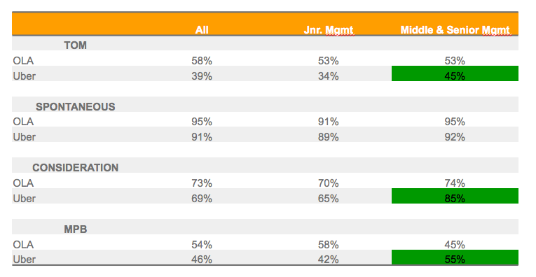
Brand metrics indicate that Ola’s brand promise is less compelling than competition’s for youth and premium customers
Key qualitative behavioural factors -
Awareness
TOM
Consideration
Brand Preference
Experience
TOM drives customer’s first preference - which is driven by awareness and experience. Eg - Prime play, if a user is aware of specific product & has a good experience then it starts driving user preference; this in turn would help in upselling
Consumertrack data shows that brand preference is higher for Uber among middle & senior management, while it is higher for Ola among junior management
Next Steps - We should have a workstream to continuously evaluate our position vs Uber on Brand preference front

Slide 15
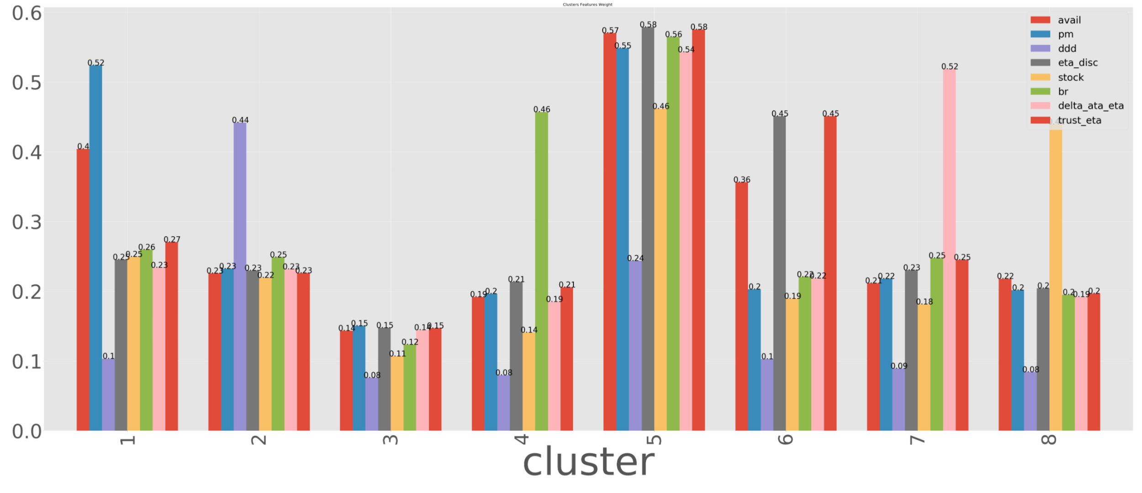
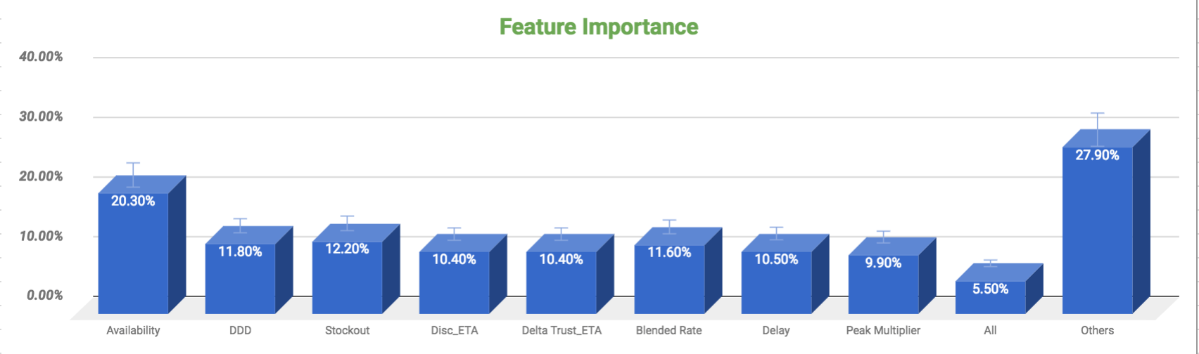
Platform level service: Availability is the most important factor

Slide 16
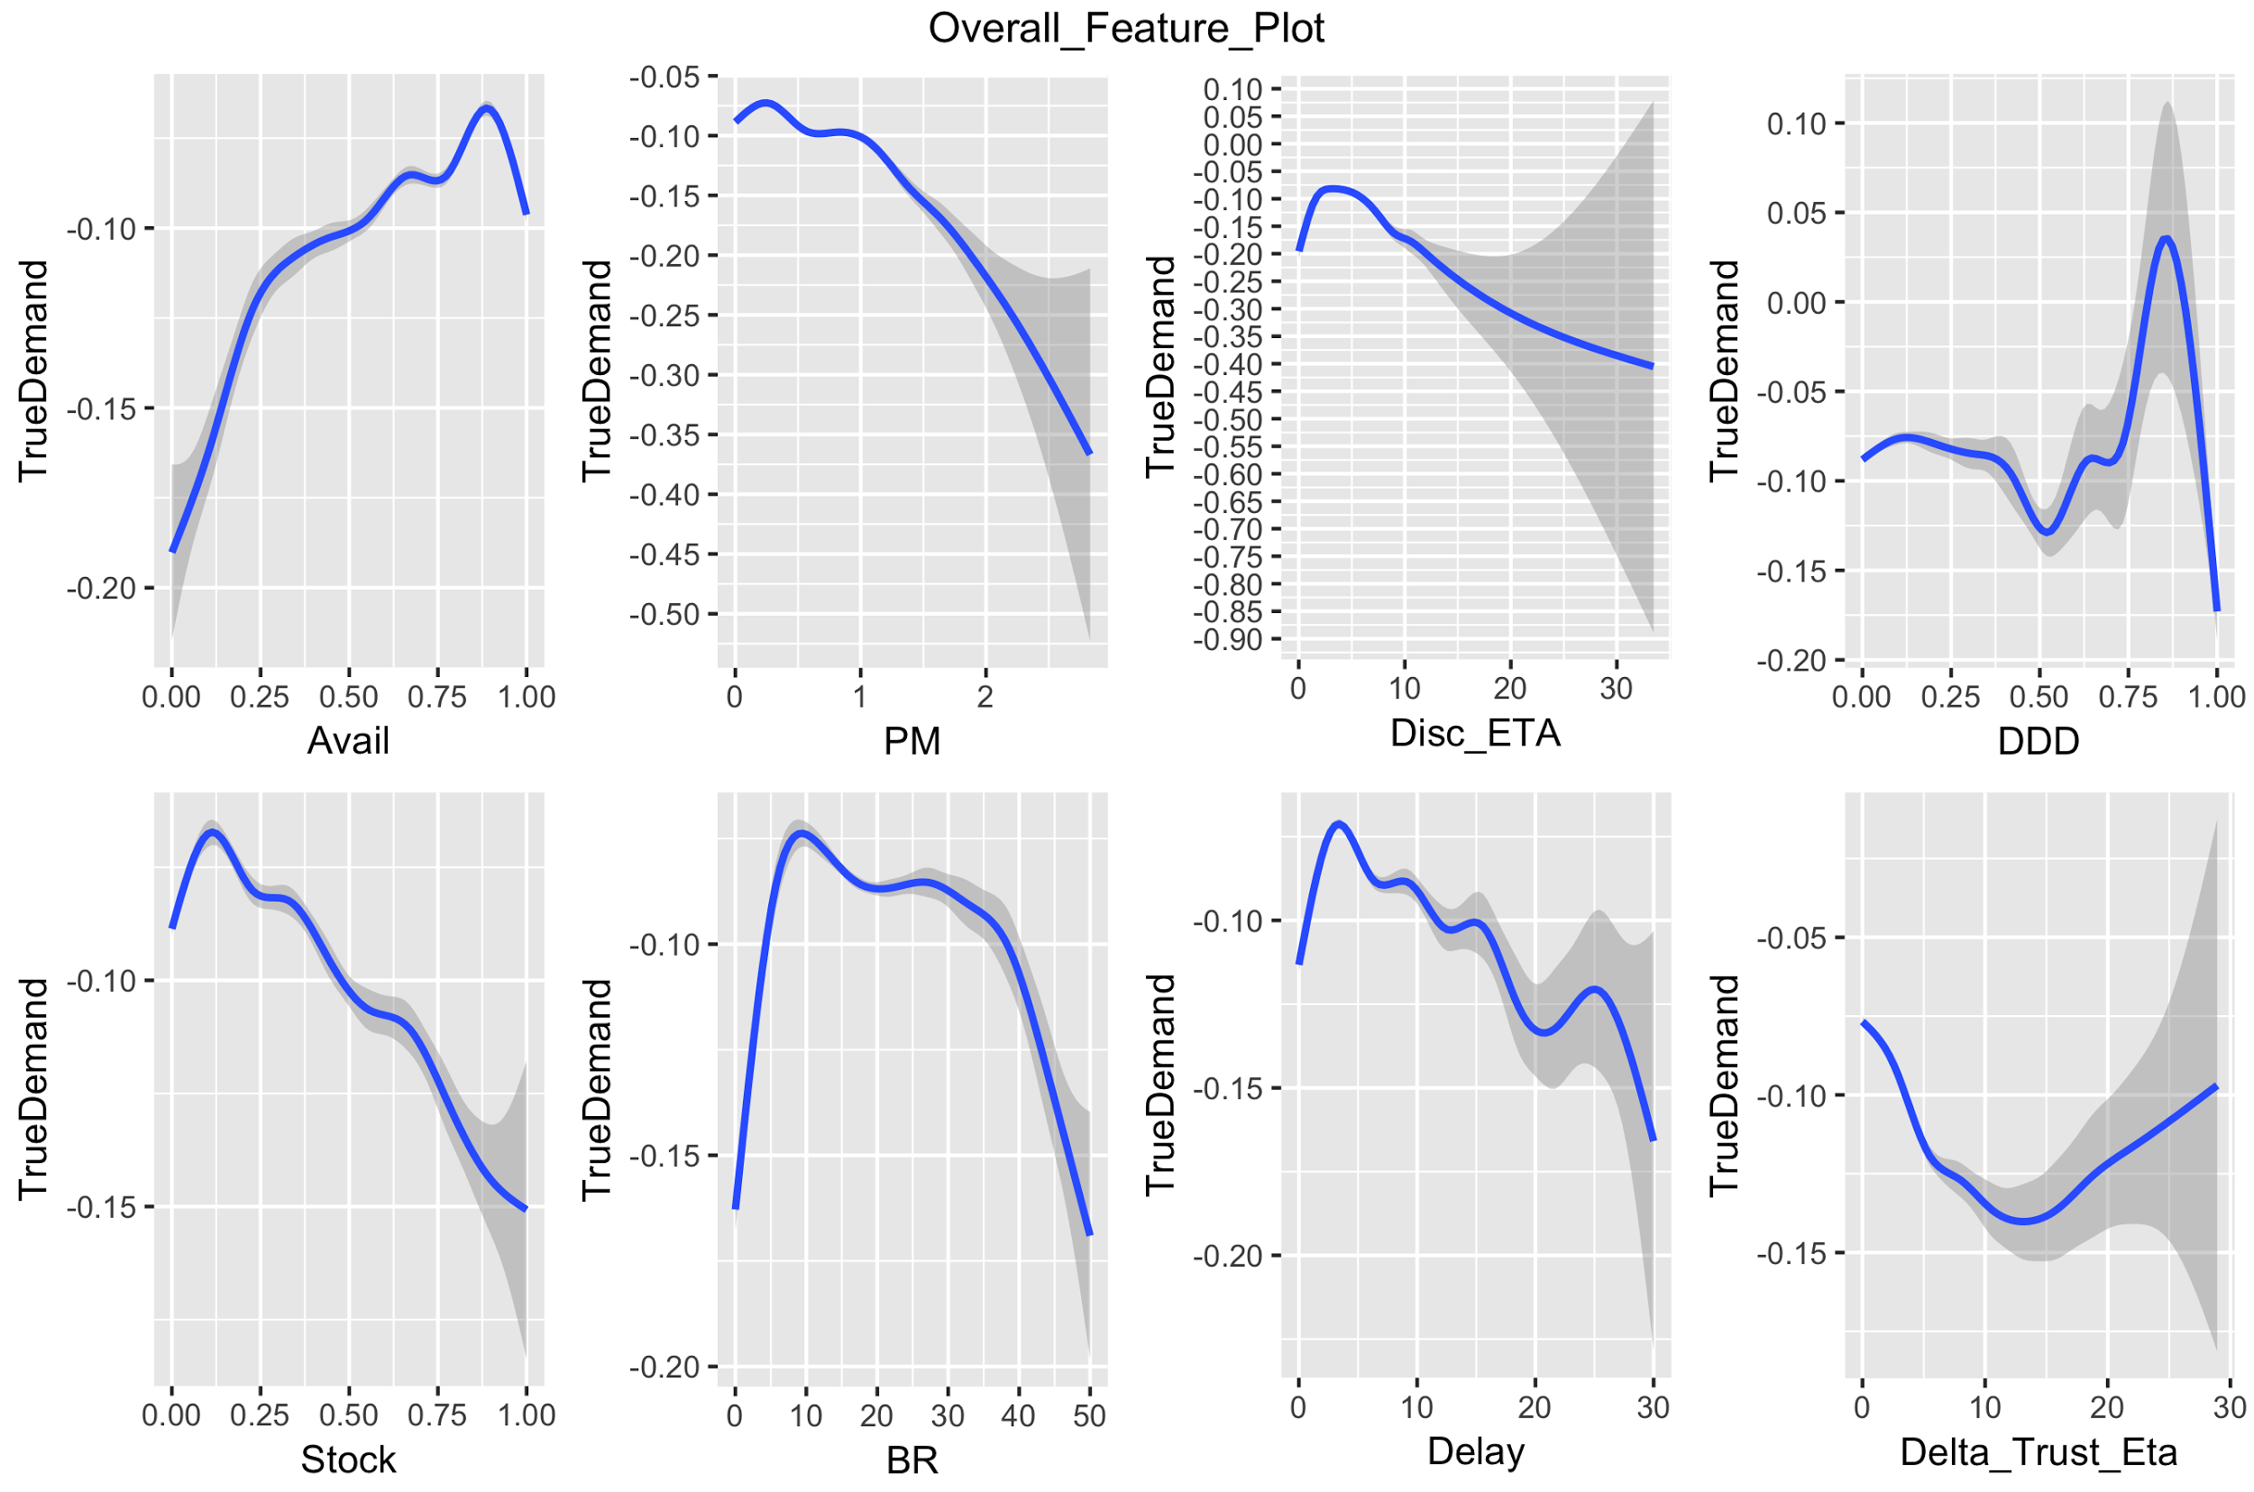
2. Insights & Patterns on Service levels
Guide on how to read graphs in following Slides -
Y-axis : change in true demand (engagement with Ola) of the user & x-axis: change in the respective variable
6 months of customer data (Mar’17 - Aug’17)
It tells the affiliation between engagement (true demand) and respective variable
The gradient shows the variability in engagement - broader the gradient, higher is the variation in the demand
Example -
Availability < 87% leads to demand fluctuation & disengagement
Notes:
Peak Multiplier - PM> 1.5 leads to disengagement

Slide 17
2. Insights & Patterns on Service levels
Availability < 87% leads to demand fluctuation & disengagement
Peak Multiplier - PM> 1.2 leads to disengagement
Discovery ETA beyond 5 minutes leads to drastic fall in engagement
DDD > 15% and >80% leads to fluctuation in engagement (Inconclusive)

Slide 18
2. Insights & Patterns on Service levels
Stock out > 13% leads to disengagement
Delay (ATA - Booking ETA) has two thresholds- beyond 3 minutes & 8 minutes that lead to high level of dis-engagement
BR has two thresholds > 10 & >27 that lead to decline in true demand & disengagement
Trust factor (ETA booking - Discovery ETA) > 5 mins leads to high level of disengagement (Inconclusive)

Slide 19
Minimum service level guarantee to deliver as a platform
Category | Metric | Minimum SLA threshold
Availability | Availability | >87%
 | DDD | <35% & < 80%
 | Stockout | <13%
Quality of availability | Discovery ETA | <5 minutes
Pricing | Peak multiplier | <1.2
 | Blended rate | <10 & <27
Reliability | Absolute Delay | <3 mins
 | Absolute Trust | <5 minutes
Next Steps
Analyze patterns from time series data, to develop deeper understanding of patterns on service levels at customer level

Slide 20
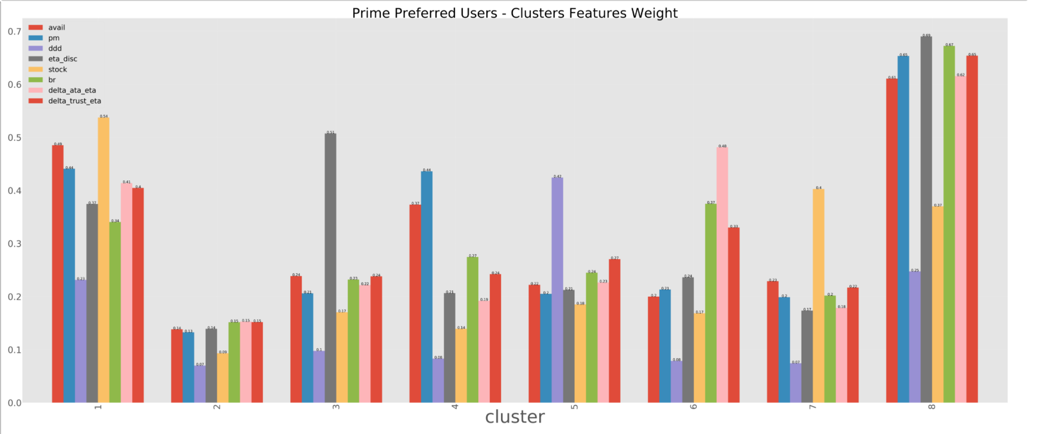
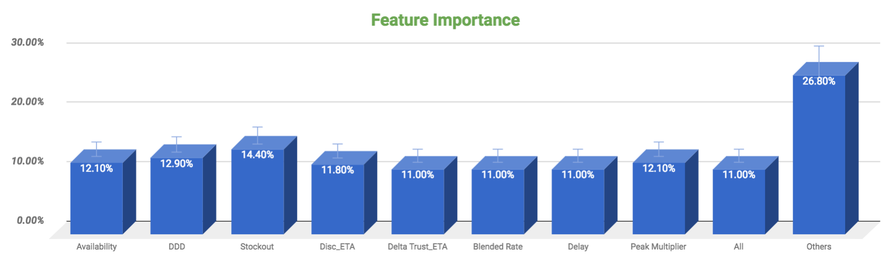
Platform level service: Availability is the most important factor (Prime)
Different set of customers sensitive to different variable viz. Availability,discovery ETA, Blended rate, Peak Pricing, Booking ETA, DDD, Actual ATA
Quantify the features

Slide 21
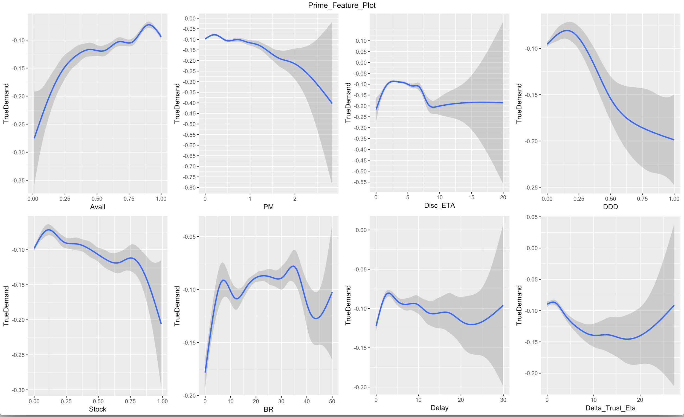
2. Insights & Patterns on Service levels (Prime)
Availability < 90% leads to demand fluctuation & disengagement
Peak Multiplier - PM> 1.3 leads to disengagement
Discovery ETA beyond 3 mins & 6 mins minutes leads to drastic fall in engagement
DDD > 15% leads to fluctuation in engagement

Slide 22
2. Insights & Patterns on Service levels (Prime)
Stock out > 10% leads to disengagement
Delay (ATA - Booking ETA) beyond 2 minutes leads to high level of dis-engagement
BR > 8 and >35 leads to disengagement (Inconclusive)
Trust factor (ETA booking - Discovery ETA) > 1 min leads to high level of disengagement

Slide 23
Minimum service level guarantee to deliver on Prime is significantly higher than platform across most metrics
Category | Metric | Minimum SLA threshold | Minimum SLA threshold (platform) | Desired gap in service level (vs. platform)
Availability | Availability | >90% | >87% | +3%
 | DDD | <15% | <15% & < 80% | Highly Sensitive
 | Stockout | <10% | <13% | +3%
Quality of availability | Discovery ETA | <3 mins & <6 mins | <5 minutes | +2 min
Pricing | Peak multiplier | <1.3 | <1.2 | +0.1
 | Blended rate | <8 & <35 | <10 & <27 | ~
Reliability | Delay | < 2 min | <3 mins & < 8 mins | +1 min
 | Trust | < 1 min | <5 minutes | + 4 minutes
Next Steps: Analyze patterns from time series data, to develop deeper understanding of patterns on service levels at customer level

Slide 24
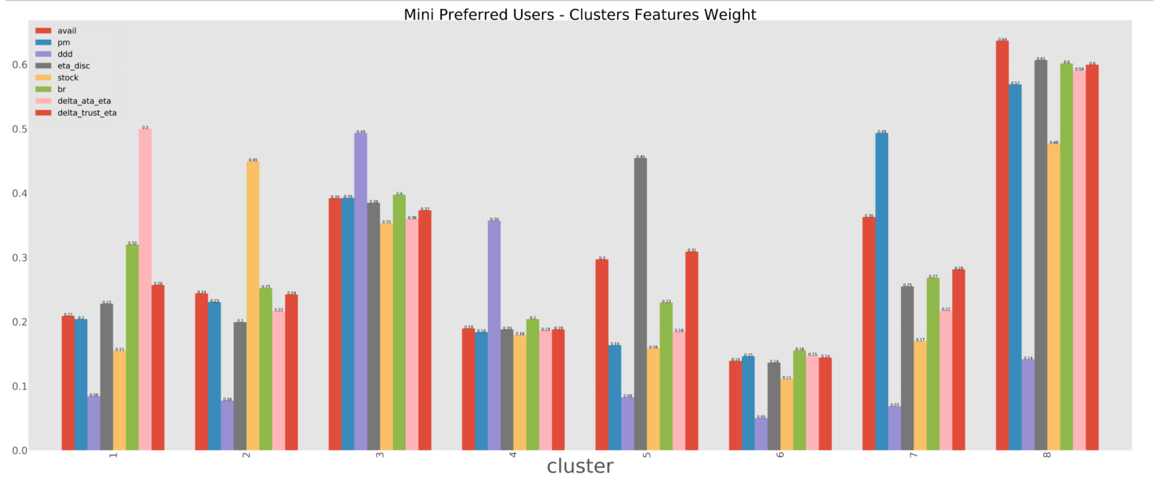
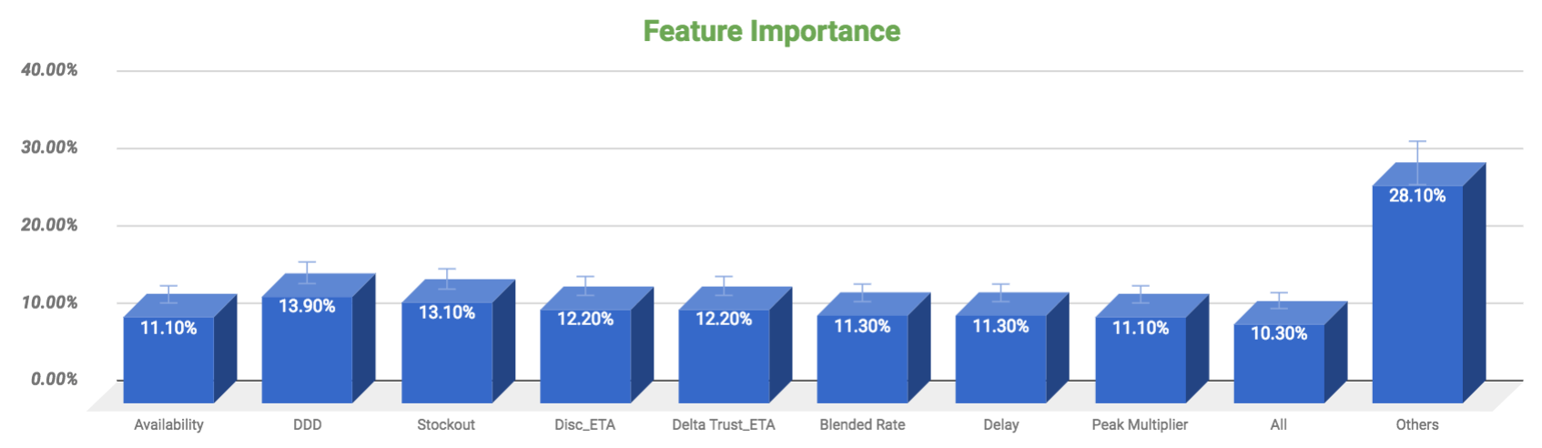
Platform level service: Availability is the most important factor (Mini)
Different set of customers sensitive to different variable viz. Availability,discovery ETA, Blended rate, Peak Pricing, Booking ETA, DDD, Actual ATA
Quantify the features

Slide 25
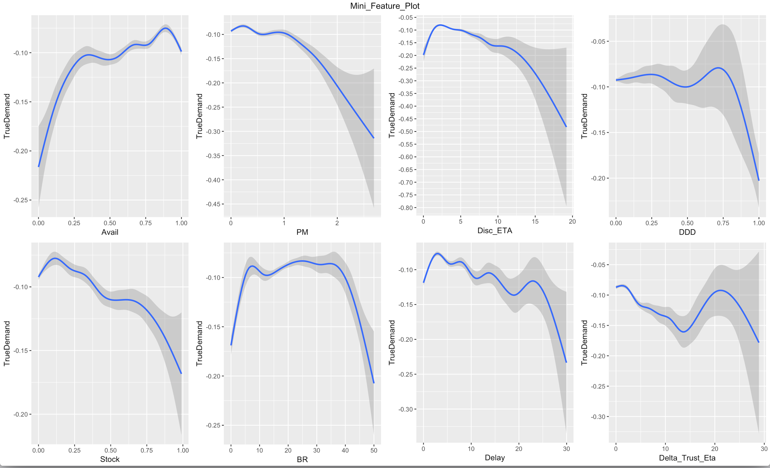
2. Insights & Patterns on Service levels (Mini)
Availability < 90% leads to demand fluctuation & disengagement
Peak Multiplier - PM> 1.2 and > 1.8 leads to disengagement
Discovery ETA beyond 2 minutes leads to drastic fall in engagement
DDD > 25% and 70% leads to fluctuation in engagement (Inconclusive)

Slide 26
2. Insights & Patterns on Service levels (Mini)
Stock out > 10% leads to disengagement
Delay (ATA - Booking ETA) beyond 3 minutes leads to high level of dis-engagement
BR > 8 and 25 leads to disengagement (Inconclusive)
Trust factor (ETA booking - Discovery ETA) > 1 min & 22 mins leads to high level of disengagement (Inconclusive)

Slide 27
Minimum service level guarantee to deliver on Mini is again higher than platform, with greater emphasis on discovery & trust ETA
Category | Metric | Minimum SLA threshold | Minimum SLA threshold (platform) | Desired gap in service level (vs. platform)
Availability | Availability | >90% | >87% | +3%
 | DDD | <25% & <70% | <15% & < 80% | ~
 | Stockout | <10% | <13% | -3%
Quality of availability | Discovery ETA | <2 min | <5 minutes | +3 mins
Pricing | Peak multiplier | <1.2 & <1.8 | <1.2 | =
 | Blended rate | <8 & <25 | <10 & <27 | ~
Reliability | Delay | < 3 min | <3 mins & < 8 mins | =
 | Trust | < 1 min | <5 minutes | +4 mins
Next Steps: Analyze patterns from time series data, to develop deeper understanding of patterns on service levels at customer level

Slide 28
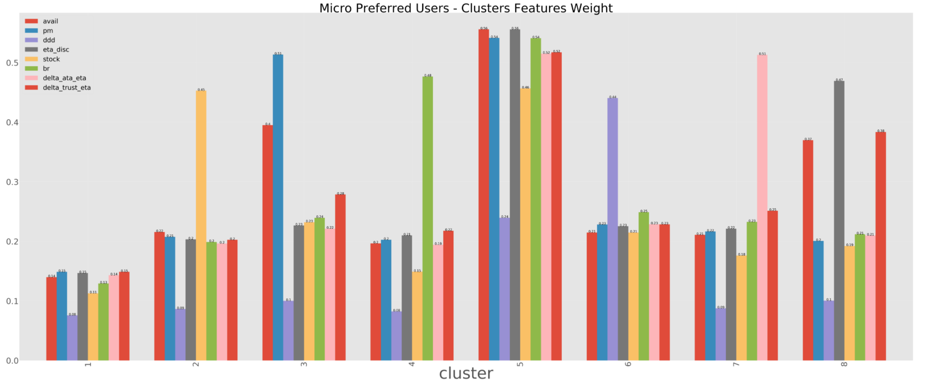
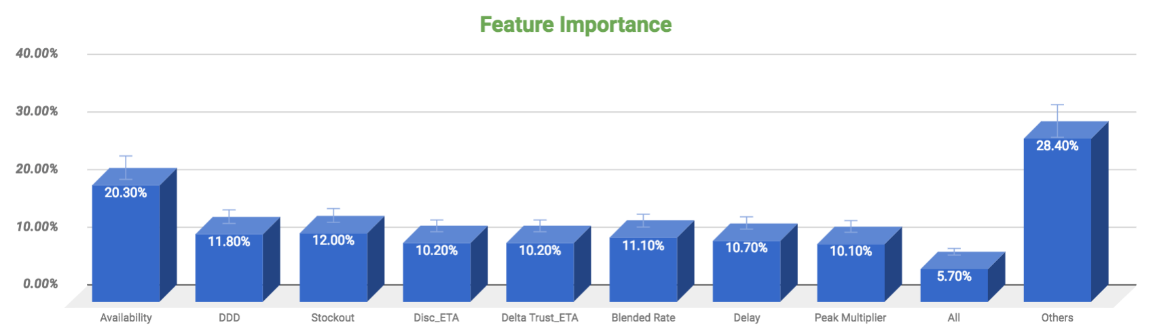
Platform level service: Availability is the most important factor (Micro)
Different set of customers sensitive to different variable viz. Availability,discovery ETA, Blended rate, Peak Pricing, Booking ETA, DDD, Actual ATA
Quantify the features

Slide 29
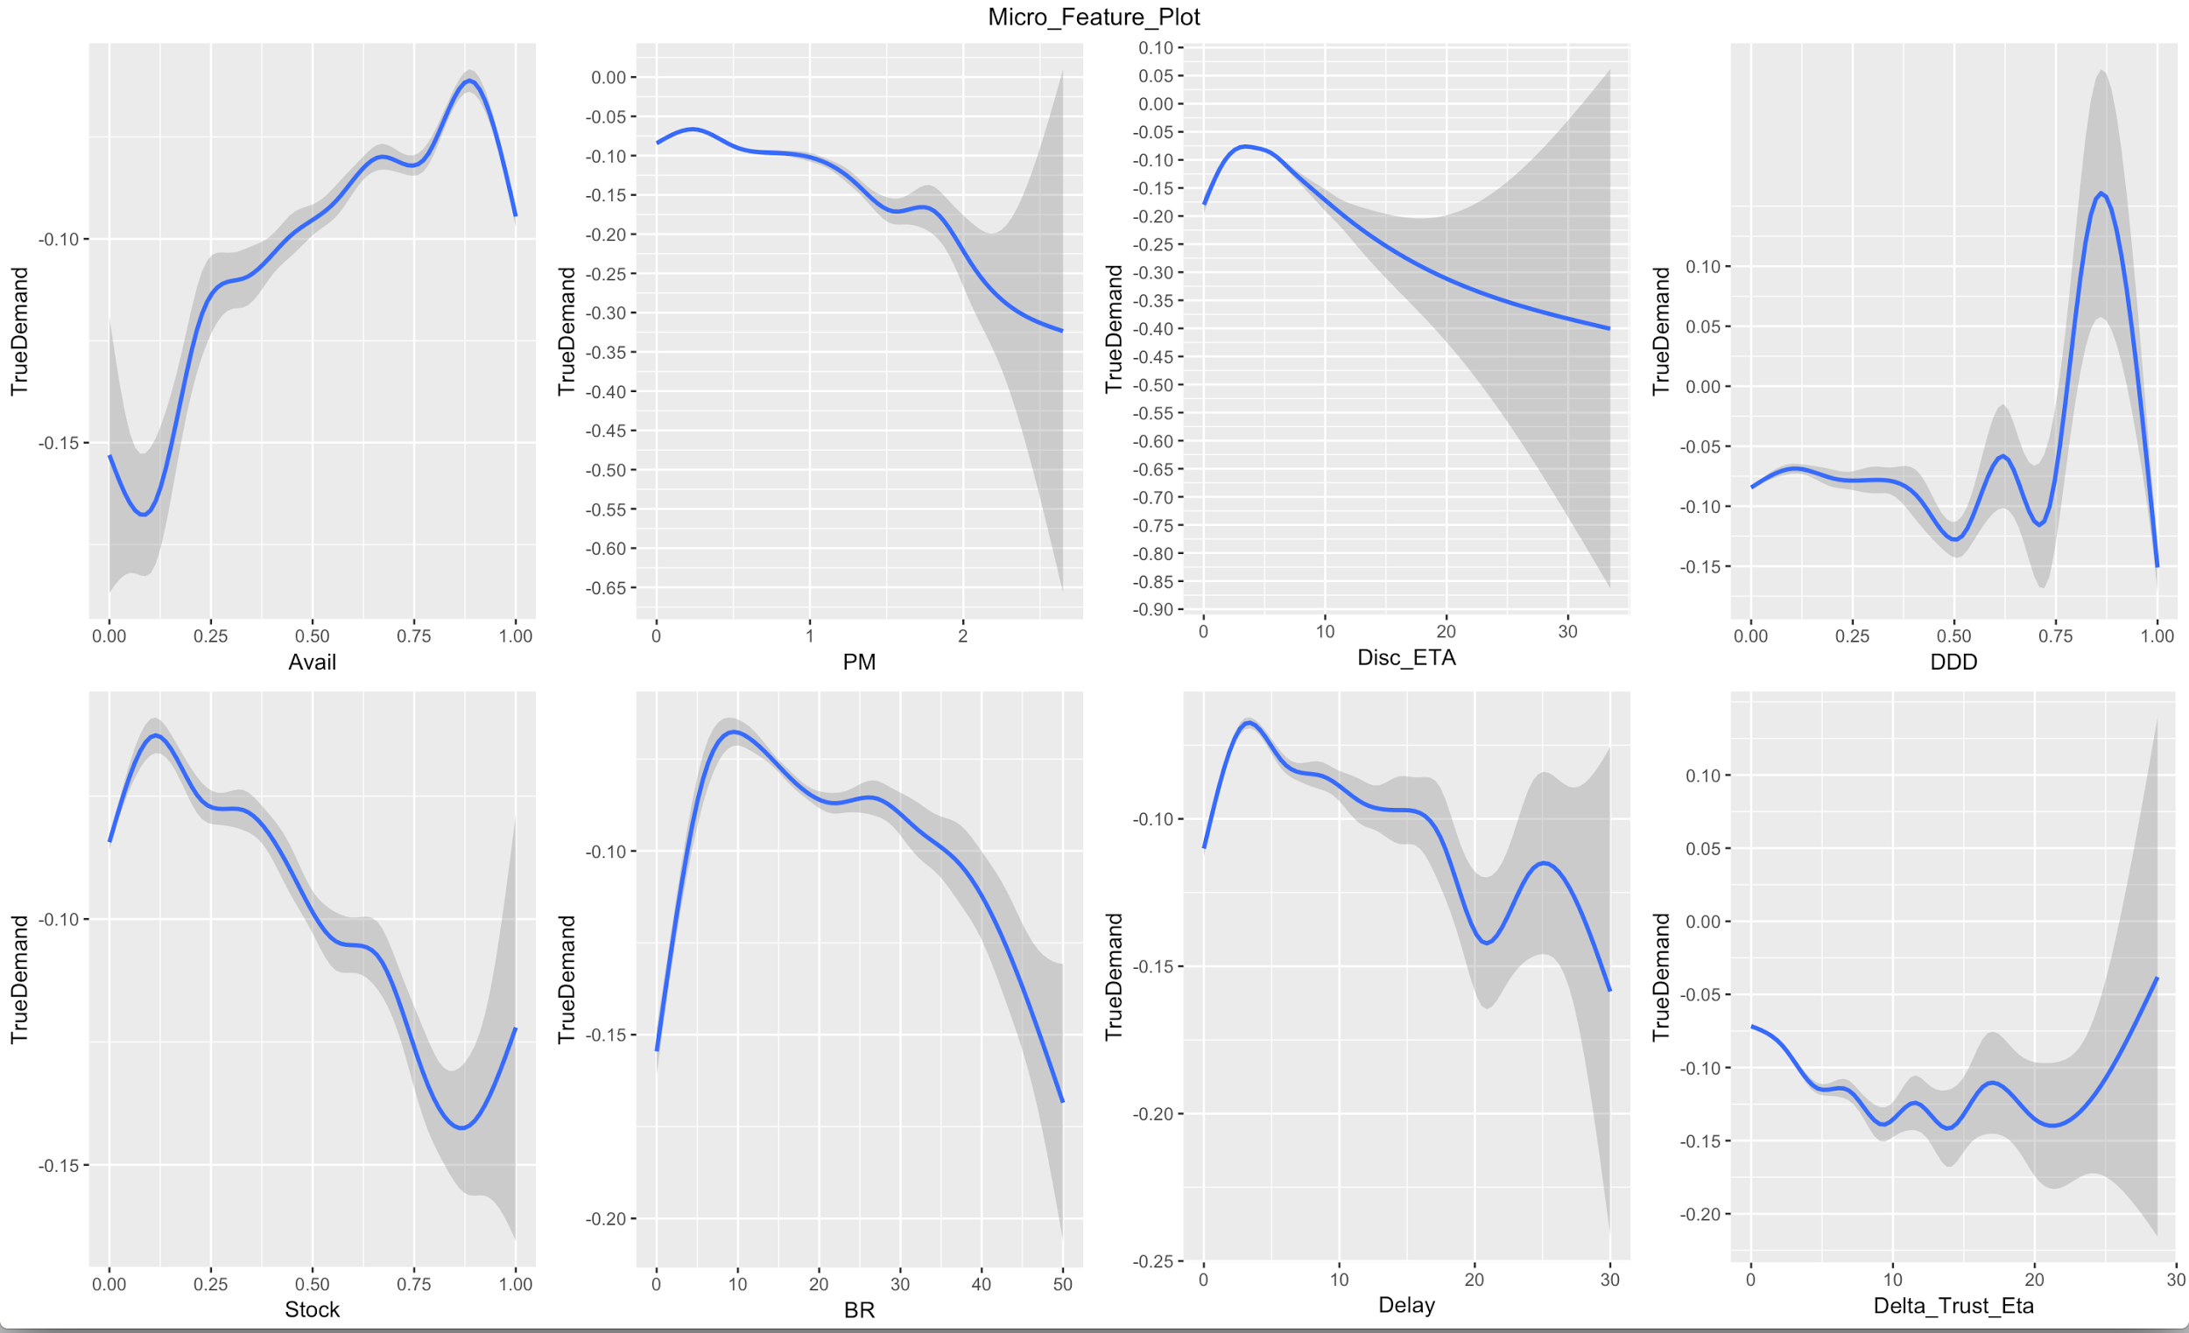
2. Insights & Patterns on Service levels (Micro)
Availability < 90% leads to demand fluctuation & disengagement
Peak Multiplier - PM> 1.2 and 2.5 leads to disengagement
Discovery ETA beyond 3 minutes leads to drastic fall in engagement
DDD > 15% and 80% leads to fluctuation in engagement (Inconclusive)

Slide 30
2. Insights & Patterns on Service levels (Micro)
Stock out > 10% leads to disengagement
Delay (ATA - Booking ETA) beyond 2 minutes leads to high level of dis-engagement
BR > 10 and >27 leads to disengagement
Trust factor (ETA booking - Discovery ETA) > 8 mins leads to high level of disengagement (Inconclusive)

Slide 31
Minimum service level guarantee to deliver on Micro is pretty similar to the platform, with greater tolerance for deviations/delays
Category | Metric | Minimum SLA threshold | Minimum SLA threshold (platform) | Desired gap in service level (vs. platform)
Availability | Availability | >90% | >87% | +3%
 | DDD | <15% and <80% | <15% & < 80% | ~
 | Stockout | <10% | <13% | -3%
Quality of availability | Discovery ETA | <3 min | <5 minutes | +2 mins
Pricing | Peak multiplier | <1.2 and <2.5 | <1.2 | ~
 | Blended rate | <10 and <27 | <10 & <27 | 0
Reliability | Delay | < 2 min | <3 mins & < 8 mins | +1 min
 | Trust | < 8 min | <5 minutes | - 3 mins

Slide 32
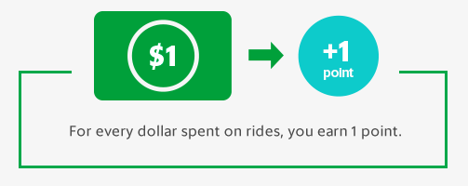
2. Loyalty Programs
It costs much more to acquire a new customer, than to sell to an existing customer. Loyalty programs increases Share of Wallet of existing customers by incentivising them to prefer our service over competitor’s
Earned Loyalty Programs
Typically reward points/miles program having tiers with accelerated earn/burn rates - to incentive users and keep them motivated to take more rides in an effort to get upgraded
First time users would see immense value in this programme
Eg Grab rewards program : Program has 4 tiers and depending on the tier users
get rewards on partners
Increases share of wallet among all types of customers - those that have predictable frequency and those who do not - as there is no upfront fee involved
Subscription Programs
Typically paid program
Effective loyalty tool among customers when usage frequency is high and predictable (thus justifying the initial fee)
Eg Amazon Prime
Increases share of wallet among subscribers - who are typically those having predictable frequency. But due to paid construct the adoption rate is limited

Slide 33
Customer Classification

Slide 34
Classification of customers for better understanding
Segment = Customer X Context
Type of Customer
Premium User - A user who prefers experience over price
Non Premium User - A user who is price conscious
Context - The use case for using a cab
Commute - Regular need, mostly fixed route or routes
Leisure - Irregular need, no fixed routes
Airport - To airport or from airport travel
For all the 6 segments identified, we will be analysing SOW and recommending constructs to build loyalty and preference in upcoming slides

Slide 35
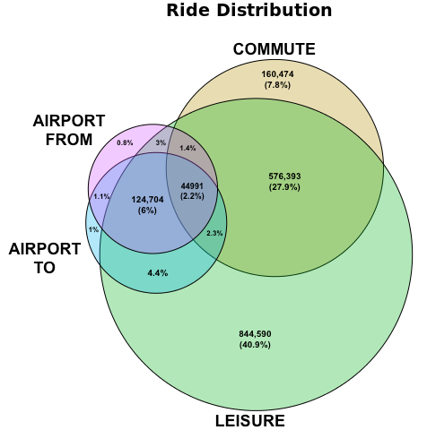
Three core segments- 1) Commute (+Leisure), 2) Leisure-only and 3) Airport
 | Commute (+ Leisure) - 25% of platform rides
 |  | Loyal | Non Loyal | Total | % Rides
Segment 1 | Non Premium | 139,320 | 624,747 | 764,067 | 26.9%
Segment 2 | Premium | 22,877 | 87,493 | 110,370 | 3.5%
 | Leisure (- Commute - Airport To/From) - 23% of platform GMV
 |  | Loyal | Non Loyal | Total | % Rides
Segment 3 | Non Premium | 126,289 | 837,266 | 963,555 | 18.3%
Segment 4 | Premium | 22,561 | 132,159 | 154,720 | 2.8%
 | Airport (To + From) - 6% of platform GMV
 |  | Loyal | Non Loyal | Total | % Rides
Segment 5 | Non Premium | 27,285 | 331,279 | 358,564 | 2.5%
Segment 6 | Premium | 9,235 | 103,053 | 112,288 | 0.8%

Slide 36
Commute (+Leisure) Segment

Slide 37
Across premium & non-premium, only ~20% of customers have Ola-preference, with GMV/user of ~Rs. 3200
Segment | Preference | #Users | Rides/ user | GMV/ User | BR | SOW | %Platform Rides | %Platform GMV
Segment 1 (Non-Premium)- 87% of total
 | Prefer-Ola | 139,320 (18%) | 16.7 | 3,202 | 15.9 | 87% | 7.6% | 7.1%
 | No preference | 624,747 (82%) | 9.5 | 1,433 | 14.7 | 41% | 19.3% | 14.2%
Segment 2 (Premium) - 13% of total | Prefer-Ola | 22,877 (20%) | 16.0 | 3,186 | 22.6 | 87% | 1.2% | 1.2%
 | No preference | 87,493 (80%) | 7.6 | 1,408 | 22.6 | 45% | 2.2% | 2.0%
Opportunity to unlock additional 54L rides/ month (1.8 L/day) from customers who do not prefer Ola
additional GMV/ month - 82 cr

Slide 38
Commute (+Leisure)
Segment 1(Non Premium Users)

Slide 39
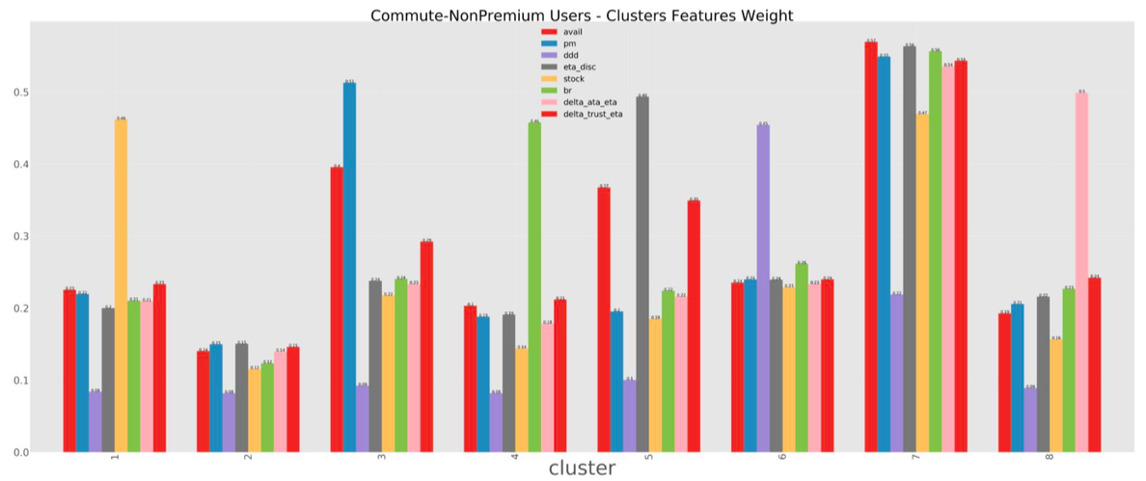
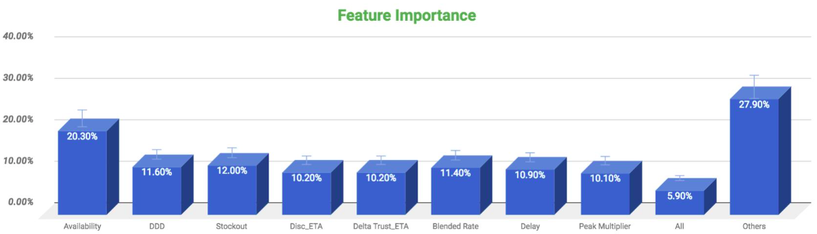
Availability is the most important factor for non premium commute segment

Slide 40
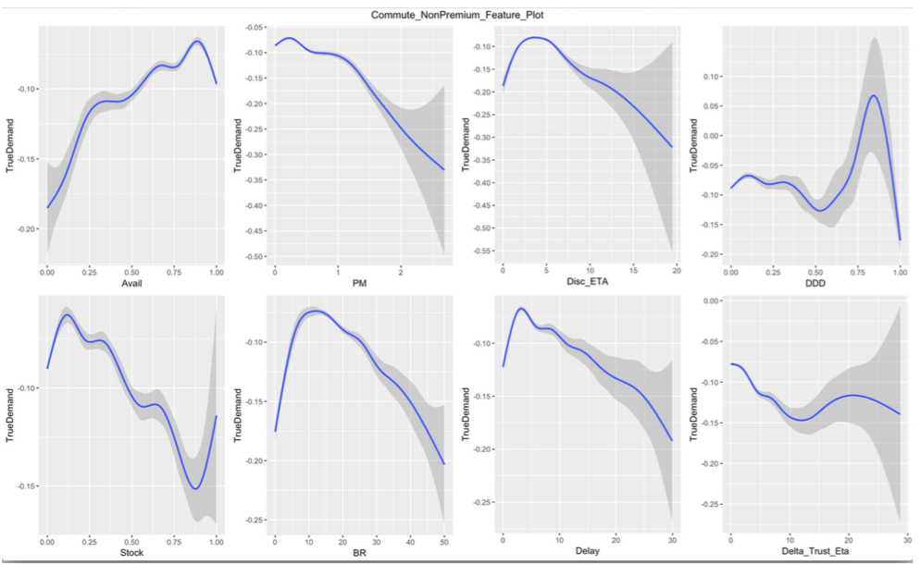
2. Insights & Patterns on Service levels
Availability < 90% leads to demand fluctuation & disengagement
Peak Multiplier - PM> 1.2 leads to disengagement
Discovery ETA beyond 4 minutes leads to drastic fall in engagement
DDD > 10% and >80% leads to fluctuation in engagement (Inconclusive)

Slide 41
2. Insights & Patterns on Service levels
Stock out > 10% leads to disengagement
Delay (ATA - Booking ETA) beyond 2 minutes leads to high level of dis-engagement
BR> 13 leads to decline in true demand & disengagement
Trust factor (ETA booking - Discovery ETA) > 5 mins and >20 mins leads to high level of disengagement (Inconclusive)

Slide 42
Commute Non Premium segment is very sensitive to delay and Blended rate & insensitive to DDD
Category | Metric | Minimum SLA threshold | Minimum SLA threshold (platform) | Desired gap in service level (vs. platform)
Availability | Availability | >90% | >87% | +3%
 | DDD | <10% and <80% | <15% & < 80% | ~
 | Stockout | <10% | <13% | +40%
Quality of availability | Discovery ETA | <4 mins | <5 minutes | +1 min
Pricing | Peak multiplier | <1.2 | <1.2 | =
 | Blended rate | <13 | <10 & <27 | Highly Sensitive
Reliability | Delay | <2 mins | <3 mins & < 8 mins | +1 mins
 | Trust | <5 mins | <5 minutes | =

Slide 43
Pass construct has had modest success (30+% penetration) among customers with Share category preference, irrespective of their Ola-preference
Pref Cat | #Users | BR | Rides/ user | SOW | %Select | %Share Pass
Auto | 13,072 | 14.9 | 22.8 | 86.4% | 2.1% | 3.9%
Micro | 56,983 | 16.5 | 15.2 | 86.5% | 3.5% | 3.7%
Mini | 22,431 | 17.5 | 13.8 | 86.6% | 5.1% | 2.8%
Prime | 11,480 | 18.0 | 18.4 | 86.6% | 15.2% | 5.3%
Share | 35,354 | 13.5 | 18.2 | 86.4% | 3.5% | 33.0%
Prefer-Ola
Pref Cat | #Users | BR | Rides/ user | SOW | %Select | %Share Pass
Auto | 54,188 | 14.3 | 12.9 | 45.0% | 1.1% | 3.2%
Micro | 240,436 | 16.1 | 7.5 | 43.3% | 1.5% | 3.5%
Mini | 88,118 | 17.2 | 6.8 | 44.0% | 2.3% | 2.8%
Prime | 42,115 | 17.8 | 8.6 | 45.0% | 9.4% | 4.5%
Share | 199,890 | 11.5 | 12.5 | 34.8% | 1.6% | 31.3%
No Preference
Share Pass creates lock-in for Share, but not necessarily for platform; need to evaluate holistic constructs that create platform wide preference OR create equivalents for other categories

Slide 44
Segment 1 - The Share pass users who have Ola-preference have lower potential (29 rides/month) as compared to those who don’t have Ola preference (54 rides/month)
Share Pass - Ola-preference
Share Pass - No preference
Pref Cat | #Users | Rides/ user | SOW | Potential
Auto | 513 | 31 | 86.4% | 36
Micro | 2,124 | 24 | 86.6% | 28
Mini | 634 | 24 | 86.4% | 27
Prime | 605 | 31 | 86.6% | 36
Share | 11,654 | 25 | 86.3% | 29
Pref Cat | #Users | Rides/ user | SOW | Potential
Auto | 1,748 | 21 | 47.2% | 44
Micro | 8,504 | 15 | 43.1% | 34
Mini | 2,436 | 14 | 43.3% | 33
Prime | 1,898 | 17 | 45.6% | 38
Share | 62,478 | 19 | 34.9% | 54
Pass constructs ability to influence “heavy users” for platform-wide preference seems more limited

Slide 45
Share Pass subscription leads to increase in rides across all use cases
Use Case | Pre Rides | Post Rides | %Change
Commute | 3.4 | 6.1 | 77%
To Airport | 0.1 | 0.1 | 78%
From Airport | 0.1 | 0.2 | 90%
Leisure | 2.2 | 4.3 | 93%
Total Rides | 5.8 | 10.7 | 84%
Use Case | Pre BR | Post BR | %Change
Commute | 9.2 | 8.4 | -8.02%
To Airport | 10.8 | 10.2 | -5.21%
From Airport | 10.9 | 10.3 | -5.68%
Leisure | 9.8 | 9.3 | -4.90%
Total Rides | 9.5 | 8.9 | -6.43%
Subscription program like Share Pass leads to increase in rides in all contexts, but the same is also possible without discounting all rides - PLEASE RE-DO THIS

Slide 46
A platform-wide “Ola Pass” can potentially unlock preference and loyalty for Micro, Mini, Prime and Auto
Program Construct - Cabs Pass
Buy a package specific to a preferred km bucket
Pay min of Flat fare/ actual fare upto threshold km limit (of that bucket)
Standard category fare post limit
Different flat fare is applicable for each category
Low gap between Micro & Mini is maintained to upsell customers to Mini
Km-buckets will be defined for each city based on the actual ride length distribution of that city
Program Construct - Auto Pass
Buy a package specific to a preferred km bucket
Pay min of Flat fare/ actual fare upto threshold km limit (of that bucket)
Higher than standard per km fare post limit
29/4 still holds true for pass users
Km-buckets will be defined for each city based on the actual ride length distribution of that city
Bangalore - Cabs Pass Flat Fares
 | Micro | Mini | Prime
upto 5 km | 75 | 80 | 90
upto 10 km | 140 | 150 | 165
upto 16 km | 210 | 220 | 240
Bangalore - Auto Pass Flat Fares
 | Upto 4 km | Upto km limit
upto 7 km | 29 | 69
upto 9 km | 29 | 99
Cabs pass to drive loyalty for Micro, Mini & Prime preferred users
Auto Pass to drive loyalty for Auto preferred users
Hence, Ola Pass umbrella (Cabs Pass, Auto Pass & Share Pass) will be able to solve for loyalty among non premium commuter segment effectively

Slide 47
Ola(Cab) Pass: Suggested Package Pricing & PnL
Mumbai
Bangalore
Subscription Price/Customer View
Km/#Ride | 5 | 10 | 20
upto 7 km | 149 | 299 | 549
upto 12 km | 199 | 349 | 699
upto 20 km | 299 | 549 | 899
Subscription Price/Customer View
Km/#Ride | 5 | 10 | 20
upto 5 km | 49 | 99 | 149
upto 10 km | 99 | 149 | 299
upto 16 km | 149 | 249 | 449
#PnL/Ola View
Km/#Ride | 5 | 10 | 20
upto 7 km | 14 | 28 | 8
upto 12 km | 28 | 7 | 15
upto 20 km | 45 | 42 | 12
#PnL/Ola View
Km/#Ride | 5 | 10 | 20
upto 5 km | 10 | 21 | 7
upto 10 km | 27 | 5 | 10
upto 16 km | 30 | 11 | 12
Levers to control burn via Flat Fares -
Flat Fare ensures that not every peak ride results in burn for us, say 5 km ride at 1.3X would be within the Flat Fare of 10km
Flat Fare limits the burn on each ride, as benefit applies upto a specific km and not on the entire ride length

Slide 48
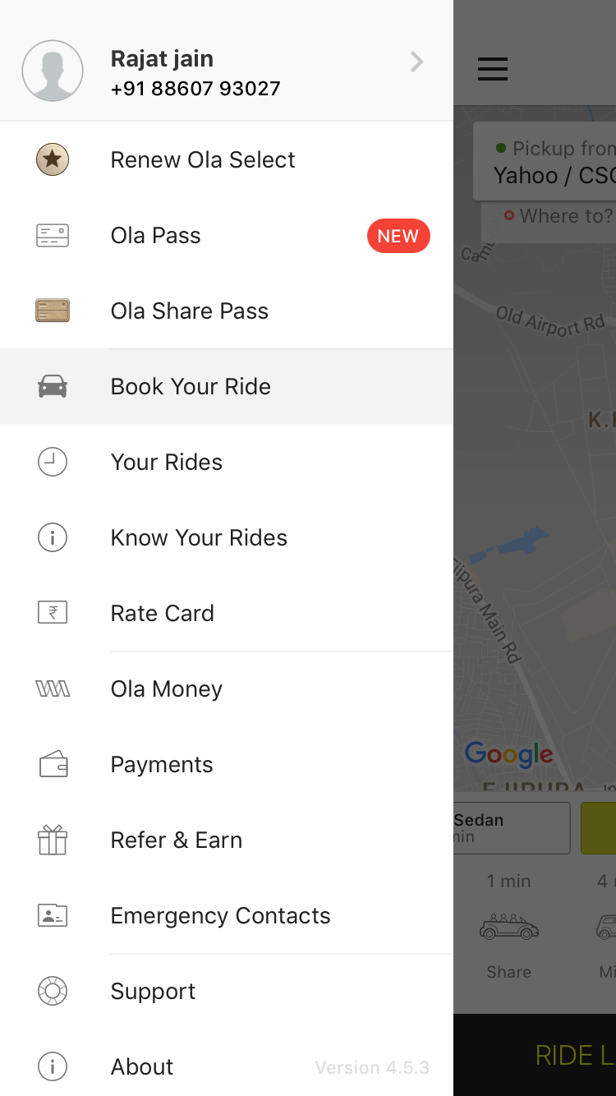
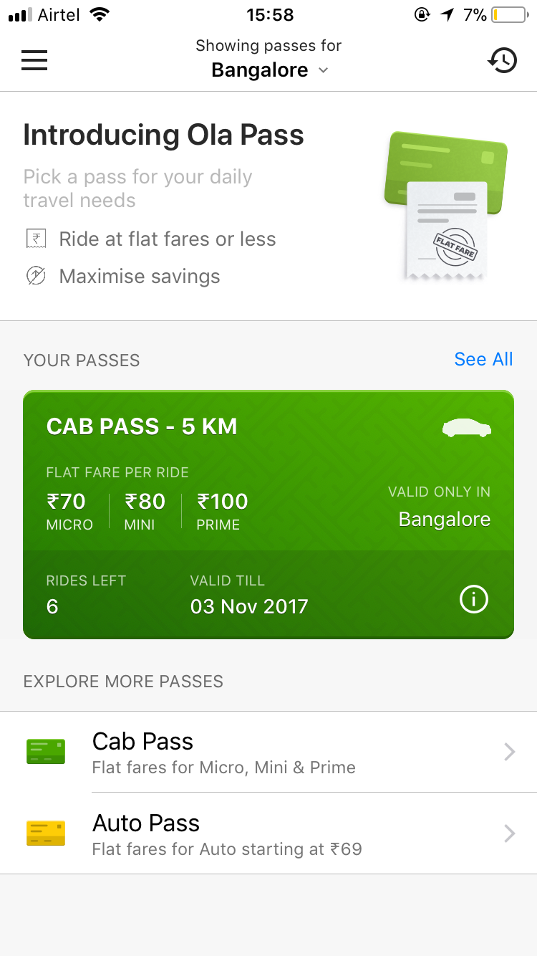
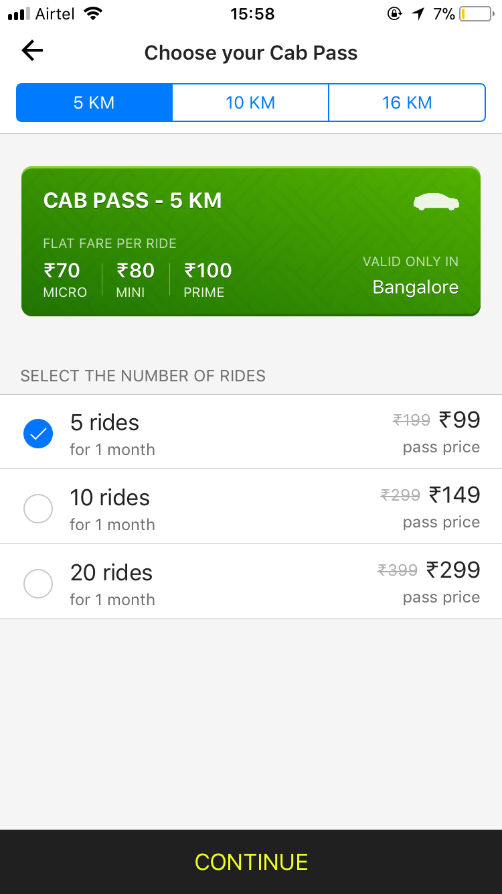
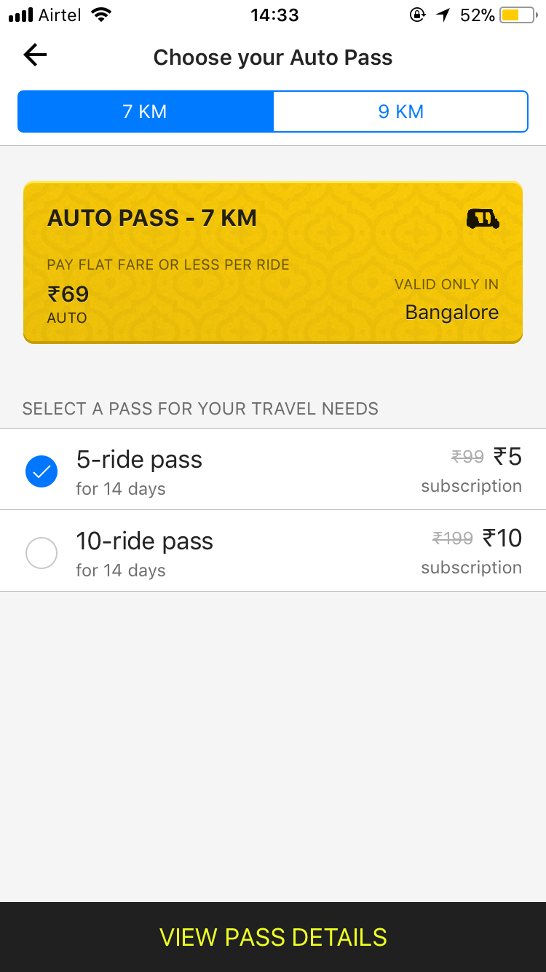
Ola Pass design

Slide 49
Do we need to discount all rides or discounting specific rides is enough?
 |  | Rides Growth |  |  |  |  | Change in BR
Km-Bucket | User Count | (0,5] | (5,10] | (10,15] | (15,Inf] | Total | (0,5] | (5,10] | (10,15] | (15,Inf] | Total
(0,5] |  | -11% | 31% | 15% | 11% | 2% | -29% | 11% | 1% | 10% | -20%
(5,10] |  | 35% | -6% | 27% | 25% | 3% | 9% | -1% | 7% | 7% | 2%
(10,15] |  | 45% | 52% | 14% | 47% | 24% | 9% | 14% | -10% | 8% | 2%
(15,Inf] |  | 69% | 66% | 64% | 54% | 56% | 17% | 16% | 13% | -4% | 20%
Discounting pref km bucket rides only, also leads to increase in rides outside pref km
It also leads to increase in overall Blended Rate of the users
Discounting preferred km rides leads to similar increase in rides within and outside preferred km bucket, which can reduce the burn by XX%

Slide 50
Ola Pass Pilot
Pilot is being run to test following constructs -
Giving discount on all rides - User will get benefit on all rides, preferred km bucket as well as outside preferred km bucket
Giving discount on rides within the KM range - User will get benefit only on rides for preferred km bucket
On the basis of results from the pilot, we will take a call on which construct to scale
Success metrics for the pilot -
Purchase rate
Ride growth of subscribers - Rides in and outside pref km bucket
Savings per user
PnL per user

Slide 51
Ola Pass GTM Plan

Slide 52
We will shape category mix dynamically to improve the economics
Intelligent category upsell to increase GMV/ km
Preferred category on daily commute - to increase stickiness on the platform
Upsell on leisure rides e.g., during weekend or to non-POI locations (for customers
Intelligent category upsell to reduce the burn
Throttle the availability of preferred category if it is at high peak
 | Micro | Mini | Prime
Current category mix | 78% | 14% | 8%
Expected Category mix | 70% | 22% | 8%
Km bucket | Change in PnL
upto 5 km | 1
upto 10 km | 10
upto 15 km | 18

Slide 53
Commute (+Leisure)
Segment 2(Premium Users)

Slide 54
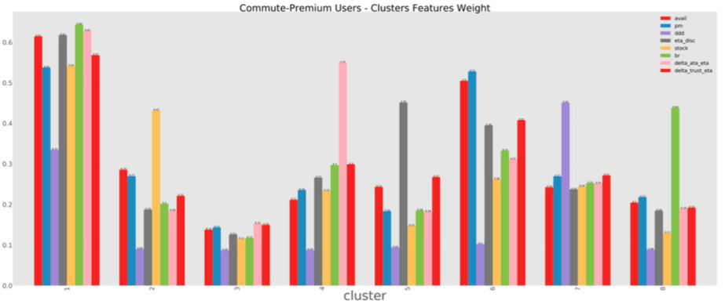
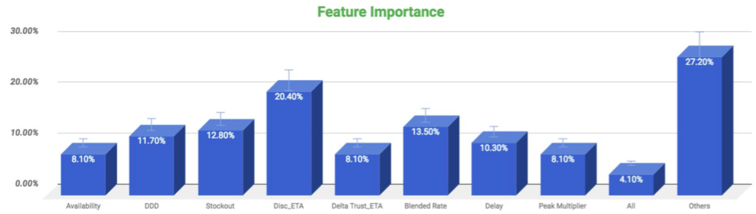
Discovery ETA is the most important factor for premium commute segment

Slide 55
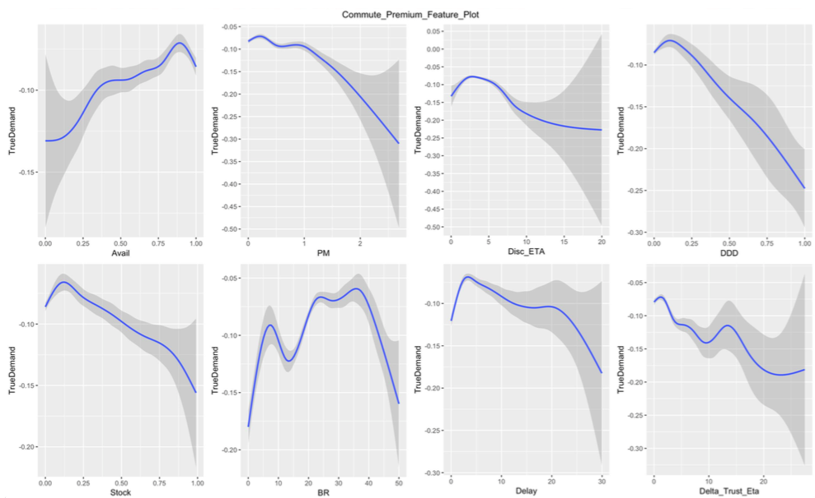
2. Insights & Patterns on Service levels
Availability < 90% leads to demand fluctuation & disengagement
Peak Multiplier - PM> 1.2 leads to disengagement
Discovery ETA beyond 3 minutes leads to drastic fall in engagement
DDD > 10% leads to fluctuation in engagement

Slide 56
2. Insights & Patterns on Service levels
Stock out > 10% leads to disengagement
Delay (ATA - Booking ETA) beyond 3 minutes leads to high level of dis-engagement
BR> 8 and >35 leads to decline in true demand & disengagement (Inconclusive)
Trust factor (ETA booking - Discovery ETA) > 2 and >12 mins mins leads to high level of disengagement (Inconclusive)

Slide 57
Commute Premium segment is very sensitive to discovery ETA and delay & has very less tolerance for DDD
Category | Metric | Minimum SLA threshold | Minimum SLA threshold (platform) | Desired gap in service level (vs. platform)
Availability | Availability | >90% | >87% | +3%
 | DDD | <5% | <15% & < 80% | Highly Sensitive
 | Stockout | <10% | <13% | -3%
Quality of availability | Discovery ETA | <3 mins | <5 minutes | +2 mins
Pricing | Peak multiplier | <1.2 | <1.2 | =
 | Blended rate | <8 & <35 | <10 & <27 | ~
Reliability | Delay | <3 mins | <3 mins & < 8 mins | =
 | Trust | <2 mins and <12 mins | <5 minutes | -3 mins

Slide 58
Select has reasonable appeal (27% penetration) to Prime users who prefer Ola
Pref Cat | #Users | BR | Rides/ user | SOW | %Select | %Share Pass
Auto | 274 | 21.2 | 21.1 | 85.4% | 4.7% | 0.7%
Micro | 6,067 | 22.6 | 16.4 | 86.6% | 3.3% | 1.4%
Mini | 8,075 | 22.7 | 14.7 | 86.6% | 3.9% | 1.0%
Prime | 8,147 | 22.5 | 16.9 | 86.5% | 27.2% | 1.6%
Share | 314 | 23.5 | 16.1 | 86.9% | 2.9% | 5.7%
Prefer-Ola
Pref Cat | #Users | BR | Rides/ user | SOW | %Select | %Share Pass
Auto | 1,470 | 20.2 | 10.4 | 40.3% | 1.9% | 0.8%
Micro | 23,343 | 22.5 | 7.7 | 45.0% | 1.4% | 1.2%
Mini | 30,599 | 22.7 | 7.0 | 44.9% | 2.2% | 1.1%
Prime | 30,873 | 22.6 | 7.9 | 45.2% | 15.6% | 1.5%
Share | 1,208 | 22.1 | 9.0 | 40.7% | 2.0% | 9.1%
No preference
Select is appealing to premium Segment having Prime as a pref cat but it’s penetration is still less than of Share Pass for customers without Ola-preference

Slide 59
Select subscription leads to increase in rides across all use cases, however PnL is negative
Use Case | Pre Rides | Post Rides | %Change
Commute | 3.8 | 6.3 | 65%
To Airport | 0.4 | 0.9 | 101%
From Airport | 0.4 | 0.8 | 104%
Leisure | 5.2 | 8.2 | 59%
Total Rides | 9.8 | 16.2 | 65%
Use Case | Pre BR | Post BR | %Change
Commute | 18.00 | 18.05 | 0.27%
To Airport | 19.40 | 19.13 | -1.41%
From Airport | 20.25 | 19.68 | -2.79%
Leisure | 18.41 | 18.34 | -0.35%
Total Rides | 18.49 | 18.44 | -0.26%
City-Wise PnL/Month
User Type | Bangalore | Chennai | Delhi | Hyderabad | Kolkata | Mumbai | Pune | Other | Overall
Buyers | 159 | 49 | 141 | -102 | -594 | -465 | 135 | 274 | -63
Select subscription leads to increase in rides across all contexts
Blended rate remains same across all use cases
Subscription program like Select is working well for Premium Prime users, however the PnL is negative ~150/month

Slide 60
“One size fits all” package led to “poor but profitable” adoption among short riders and “higher adoption, but unprofitable” among long riders
Distance Preference | %HF Users | %Select Users | %Select HF Penetration | PnL
0-5km | 22% | 14% | 6% | 159
5-10km | 28% | 25% | 8% | 64
10-15km | 20% | 21% | 9% | -47
>15km | 30% | 41% | 12% | -240
Total | 100% | 100% | 9% | -63
Low adoption- only 40K paid
One package for all at same price
Low ROI for short riders(0-10km) due to high pricing
High Burn Rate (- Rs. 240 per user)
Long riders(10+KM) have high adoption rate that skews the burn rate towards higher side
No “Shampoo Sachet” to induce trials
As can be seen majority of first time purchasers of Share Pass come on 5 Ride package
Due to non-existence of this package, Select couldn’t generate enough trails and gain traction
Share Pass re-purchasers | 5@199 | 10@299 | 20@399 | 40@499
1 | 44% | 39% | 13% | 5%
2 | 33% | 40% | 20% | 8%
3 | 23% | 44% | 24% | 9%
4 | 19% | 44% | 26% | 11%
5 | 17% | 43% | 28% | 11%
6 | 16% | 42% | 30% | 12%
7 | 16% | 41% | 30% | 12%
8 | 16% | 40% | 31% | 13%
9 | 17% | 40% | 31% | 12%
10 | 18% | 41% | 30% | 11%
“One size fits all” was the main reason for limited and unprofitable scale of Select
How to Solve this - Break Select into preferred km buckets just like Ola pass
Notes:
Add the contrast with Share as a learning

Slide 61
Select Way Forward - Option 1
Keep select as it is, outside of Pass
Pros
Select as a package continues to stay which has premium appeal in the market
Cons
May cause confusion eg Select user wanting Flat Fare of Ola Pass cannot take it till Select expires
Notes:
Break in KM bucket, Move from No Peak to FF, Limit rides, also have 1 pass which will have FF for all buckets and UL rides (current members to be transitioned to this pack)

Slide 62
Select Way Forward - Option 2
Break Select in km buckets just like Ola Pass
Add “overall package” to offer Flat Fare on all km buckets in Ola Pass
Transition current Select users to overall package
Upsell Select benefits on these packages in Pass
Pros
Move from No Peak to Flat Fares, gives more flexibility to manage burn
Flat Fare ensures that not every peak ride results in burn for us, say 5 km ride at 1.3X would be within the Flat Fare of 10km
Flat Fare limits the burn on each ride, as benefit applies up to a specific km and not on the entire ride length
Cons
Select will be city specific offering, rather than PAN India offering
Notes:
Break in KM bucket, Move from No Peak to FF, Limit rides, also have 1 pass which will have FF for all buckets and UL rides (current members to be transitioned to this pack)

Slide 63
Select Way Forward - PAN India appeal
82% users do not take rides outside Primary city
18% users take rides outside Primary city
5% users do not get any benefit on those rides
13% user get benefit on the rides outside primary city - 20% of their rides get Select benefits outside primary city
Plus
Clear trip(free of cost)
Notes:
Break in KM bucket, Move from No Peak to FF, Limit rides, also have 1 pass which will have FF for all buckets and UL rides (current members to be transitioned to this pack)

Slide 64
Select can further be improved by delivering on promised benefits
Priority Availability
Top rated drivers
 | Mini Availability
 | W40 | W41 | W42 | W43
Select | 66% | 64% | 62% | 72%
Non Select | 61% | 61% | 62% | 67%
 | Prime Availability
 | W40 | W41 | W42 | W43
Select | 70% | 72% | 62% | 74%
Non Select | 62% | 63% | 58% | 64%
 | DDD
 | W40 | W41 | W42 | W43
Select | 1.5% | 1.6% | 1.8% | 1.7%
Non Select | 1.9% | 2.0% | 2.0% | 2.2%
Next Steps
Select customer communication to driver - Inform the driver about Select customer booking and this booking has higher weightage to Ola Score (DDD or 5 star)
Priority availability tag to set realistic expectations of cab availability
Unable to fulfill the delivered promise has been another reason for limited scale of Select

Slide 65
Leisure Segment

Slide 66
Among the leisure-segment, <15% prefer Ola, across both non-premium and premium customers
Segment | Preference | #Users | Rides/ user | GMV/ User | BR | SOW | %Platform rides | %Platform GMV
Segment 3 (Non-Premium) | Prefer-Ola | 126,289 (13.5%) | 10.9 | 2,699 | 16.8 | 86% | 4.5% | 5.4%
 | No preference | 837,266 (86.5%) | 5.1 | 1,043 | 16.2 | 39% | 13.8% | 13.8%
Segment 4 (Premium) | Prefer Ola | 22,561 (14.5%) | 10.7 | 3,168 | 22.4 | 86% | 0.8% | 1.1%
 | No preference | 132,159 (85.5%) | 4.7 | 1,228 | 22.0 | 42% | 2.0% | 2.6%
Opportunity to unlock additional 44L rides/ month (1.5 L/day) from Non Loyal customers
additional GMV/ month - 93 cr

Slide 67
Leisure
Segment 3(Non - Premium Users)

Slide 68
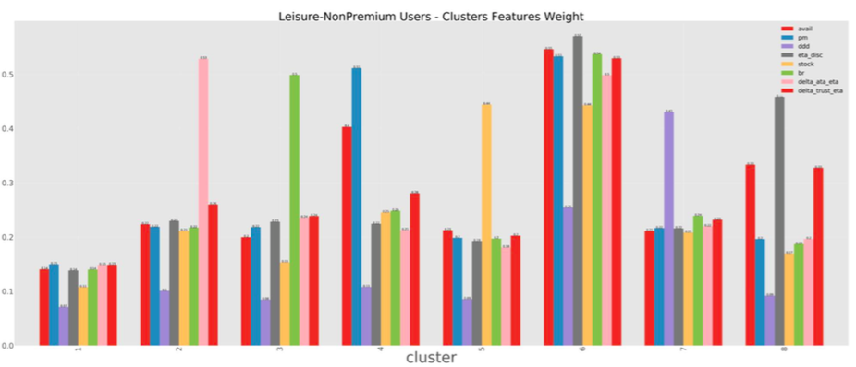
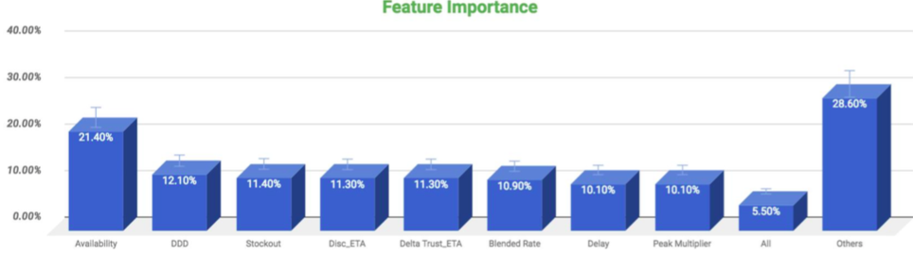
Availability is the most important factor for Non premium leisure segment

Slide 69
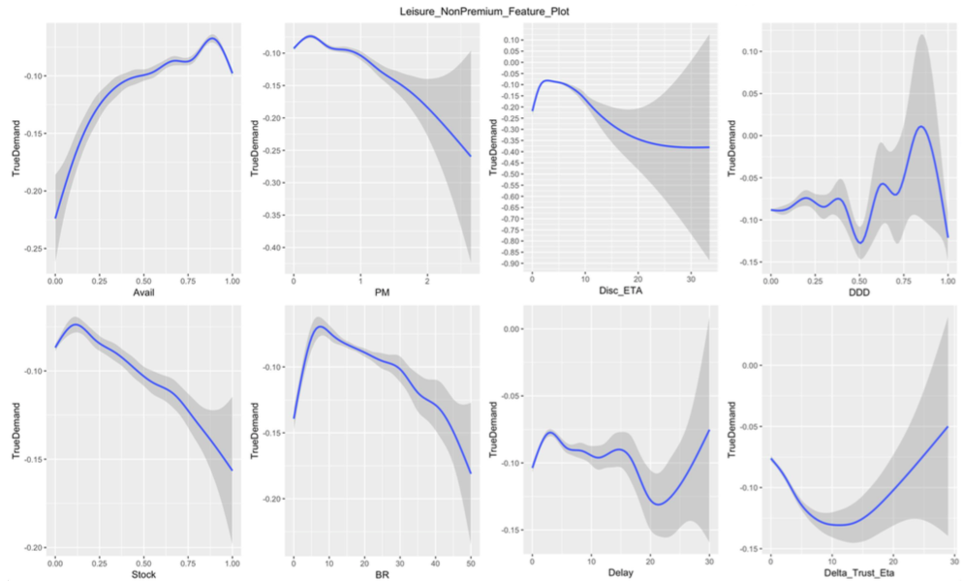
2. Insights & Patterns on Service levels
Availability < 90% leads to demand fluctuation & disengagement
Peak Multiplier - PM> 1.2 leads to disengagement
Discovery ETA beyond 2 minutes leads to drastic fall in engagement
DDD>20% and >80% leads to disengagement (Inconclusive)

Slide 70
2. Insights & Patterns on Service levels
Stock out > 10% leads to disengagement
Delay (ATA - Booking ETA) beyond 3 minutes leads to high level of dis-engagement (Inconclusive)
BR> 8 leads to decline in true demand & disengagement
Trust factor (ETA booking - Discovery ETA) (Inconclusive)

Slide 71
Leisure non premium segment is very sensitive to Blended rate & has very high tolerance for DDD & delay
Category | Metric | Minimum SLA threshold | Minimum SLA threshold (platform) | Desired gap in service level (vs. platform)
Availability | Availability | >90% | >87% | +40%
 | DDD | <20% and <80% | <15% | ~
 | Stockout | <10% | <13% | +40%
Quality of availability | Discovery ETA | <2 mins | <5 minutes | -3 mins
Pricing | Peak multiplier | <1.2 | <1.2x | =
 | Blended rate | <8 | <10 & <27 | -2 (highly sensitive)
Reliability | Delay | <3 mins | <3 mins & < 8 mins | =
 | Trust | NA | <5 minutes | ~

Slide 72
Segment 3 - Leisure (Non Premium Users) segment does not have affinity towards any subscription program
Pref Cat | #Users | BR | Rides/ user | SOW | %Select | %Share Pass
Auto | 5,329 | 15.5 | 15.2 | 86.2% | 1.1% | 2.1%
Micro | 53,303 | 17.1 | 10.7 | 86.4% | 1.9% | 2.9%
Mini | 27,613 | 17.8 | 10.1 | 86.4% | 2.4% | 1.9%
Prime | 12,161 | 18.1 | 11.3 | 86.3% | 7.2% | 3.1%
Share | 27,883 | 15.1 | 11.0 | 86.4% | 1.9% | 17.0%
Loyal
Pref Cat | #Users | BR | Rides/ user | SOW | %Select | %Share Pass
Auto | 35,814 | 15.1 | 6.9 | 40.9% | 0.4% | 1.8%
Micro | 361,618 | 16.6 | 4.7 | 40.1% | 0.8% | 2.4%
Mini | 177,332 | 17.6 | 4.5 | 40.6% | 1.2% | 1.7%
Prime | 77,899 | 18.0 | 5.0 | 40.5% | 4.5% | 2.6%
Share | 184,603 | 13.5 | 6.1 | 34.5% | 0.9% | 15.9%
Non - Loyal
Penetration of Select as well as Share pass is quite low for this segment, as compared to commute
Subscription programs do not work for this segment
Notes:
remove SP/Select penetration from here and add on next slide at pref cat level
talk abput opportunity that can be unlocked on this slide

Slide 73
Leisure
Segment 4 (Premium Users)

Slide 74
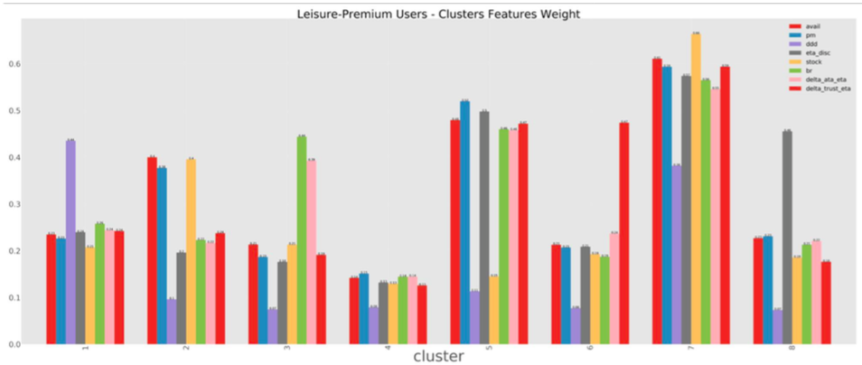
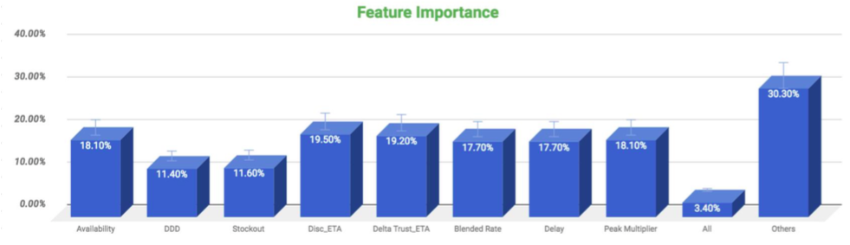
Discovery ETA is the most important factor for Premium leisure segment

Slide 75
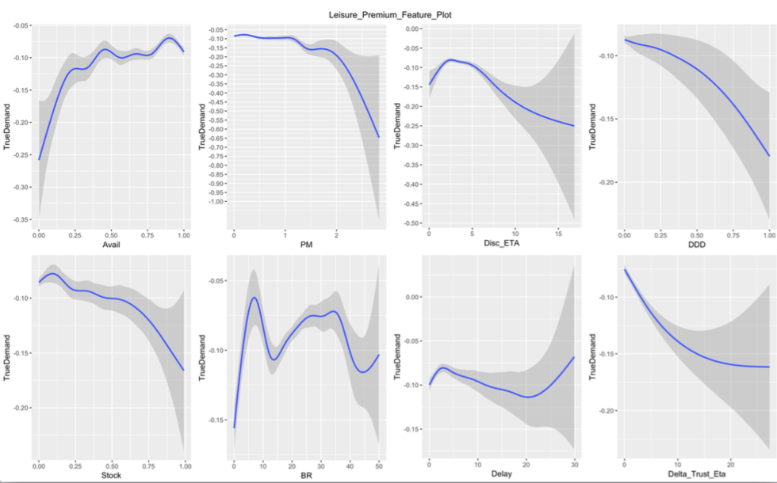
2. Insights & Patterns on Service levels
Availability < 90% leads to demand fluctuation & disengagement
Peak Multiplier - PM>2 leads to disengagement
Discovery ETA beyond 2 minutes leads to drastic fall in engagement
Highly sensitive to DDD

Slide 76
2. Insights & Patterns on Service levels
Stock out > 10% leads to disengagement
Delay (ATA - Booking ETA) beyond 2 minutes leads to high level of dis-engagement (Inconclusive)
BR> 8 and >35 leads to decline in true demand & disengagement (Inconclusive)
Trust factor (ETA booking - Discovery ETA) - Highly sensitive

Slide 77
Leisure Premium segment is very sensitive to DDD and trust (discovery & booking ETA) and has high spending behaviour to avail better service
Category | Metric | Minimum SLA threshold | Minimum SLA threshold (platform) | Desired gap in service level (vs. platform)
Availability | Availability | >90% | >87% | +3%
 | DDD | <5% | <15% | Highly sensitive
 | Stockout | <10% | <13% | -3%
Quality of availability | Discovery ETA | <2 mins | <5 minutes | -7 mins
Pricing | Peak multiplier | <2 | <1.2 | +0.8
 | Blended rate | <8 & <35 | <10 & <27 | ~
Reliability | Delay | <2 mins | <3 mins & < 8 mins | +1 min
 | Trust | <1 min | <5 minutes | Highly sensitive

Slide 78
Segment 4 - Leisure (Premium Users) segment also does not have affinity towards any subscription program
Pref Cat | #Users | BR | Rides/ user | SOW | %Select | %Share Pass
Auto | 81 | 22.3 | 8.5 | 86.2% | 1.2% | 1.2%
Micro | 4,530 | 22.4 | 11.1 | 86.8% | 1.5% | 1.0%
Mini | 8,374 | 22.3 | 10.1 | 86.3% | 2.0% | 0.9%
Prime | 9,326 | 22.4 | 10.9 | 86.2% | 12.5% | 1.0%
Share | 250 | 23.1 | 11.4 | 87.8% | 2.4% | 6.8%
Loyal
Pref Cat | #Users | BR | Rides/ user | SOW | %Select | %Share Pass
Auto | 872 | 19.8 | 4.2 | 32.3% | 0.6% | 0.1%
Micro | 25,928 | 21.9 | 4.4 | 41.7% | 0.8% | 0.8%
Mini | 47,940 | 22.0 | 4.5 | 42.1% | 1.1% | 0.8%
Prime | 56,189 | 22.1 | 4.9 | 42.2% | 7.1% | 0.9%
Share | 1,230 | 22.9 | 4.2 | 41.6% | 0.7% | 6.8%
Non - Loyal
Penetration of Select as well as Share pass is quite low for this segment, as compared to commute
Subscription programs do not work for this segment
Notes:
remove SP/Select penetration from here and add on next slide at pref cat level
talk abput opportunity that can be unlocked on this slide

Slide 79
Subscription program does not work for Leisure segment, need to explore other constructs for loyalty
Subscription Program- X (Ruled Out)
Earned Loyalty Program - Possible
Benefits of Earned Loyalty Program
Users don't need to pay upfront to avail benefits
Frequent customers earn more and get rewarded
Tier system encourages repeat behaviour of less frequent customers
Gamification of the program leads to increased customer engagement
Getting rewarded on every ride will lead to greater customer engagement

Slide 80
Validation - Frequency of discount drives the ride frequency of the users, the quantum of discount is almost irrelevant (beyond Rs. 25/ride)!
Number of discounted rides
Ride growth | 1 | 2 | 3 | 4 | 5 | 5-10 | >10 | #Users
1-25 | -55% | -24% | -1% | 12% | 20% | 40% | 72% | 36,332
25-50 | -45% | -8% | 20% | 38% | 53% | 76% | 87% | 106,935
50-75 | -40% | 3% | 27% | 41% | 51% | 48% | 66% | 45,842
75-100 | -47% | -12% | 18% | 40% | 54% | 62% | 73% | 39,867
>100 | -51% | -14% | 11% | 35% | 45% | 67% | 82% | 114,320
#Users | 61,684 | 58,326 | 44,525 | 34,646 | 26,398 | 67,898 | 49,819 | 343,296
Discount per ride
Users who have taken a discounted ride in the month of Aug
Growth in rides wrt to previous month
It can be seen that similar growth is observed among users who are offered discount > 25/ ride under different number of discounted rides
Thus earned loyalty construct can be an effective tool to drive loyalty as it would give value to the customer on every ride

Slide 81
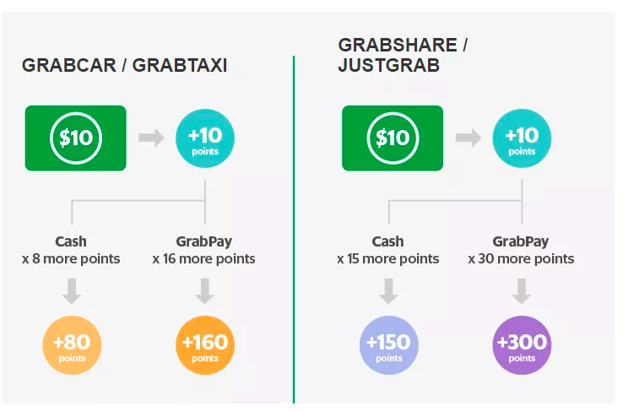
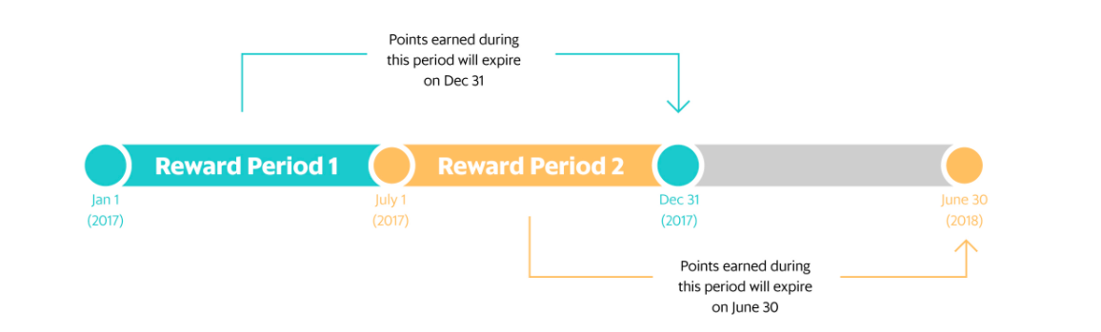
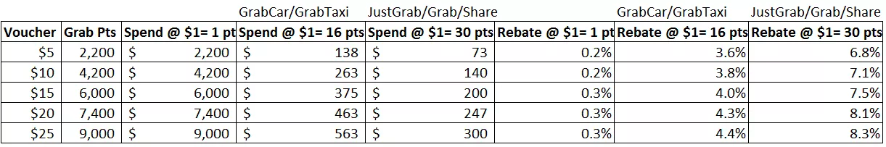
Global Examples - Grab Taxi
Points Earning Parameter - Spend on Grab
Tiers - 4 tiers in the program
Earn points ($1 = 1 point)
Earn 2x point when pay via Grab pay
Earn accelerated points
Burn points basis tiers (higher benefits as you upgrade)
On the platform - Grab Rides
On partners - KFC, Singapore airlines, etc
Economics - Baselining of points is 0.2 - 0.3% and with boosters they give away ~6-8% to manage economics
Tiering depends on points earned in fixed 6 month cycles - say 1st Jan to 30th June & these points expire in next 6 months (31st Dec)

Slide 82
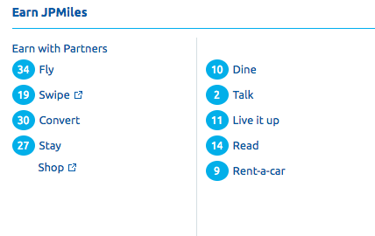
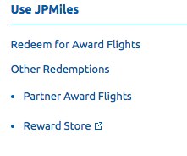
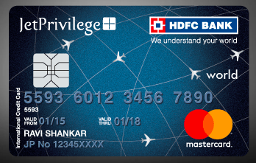
JetPrivilege
Points Earning Parameter - Spend on Jet Airways & Partners
Tiers - 4 tiers in the program
Earn points (depending on the tier)
Earn bonus miles depending on the tier
Buy miles directly at a discounted price
Earn miles by spending on JetPrivilege exclusive card
Burn points
On the platform - Jet Flights + Partner Flights
On a specific catalog maintained at JP website
Economics - Baselining of points is low and have variable points for each tier 25%, 50%, 75% to give away value
Tiering depends on points earned in fixed 6/12 month cycles
Also issued Co-branded Cards
Co branded HDFC card, followed by Amex, Citi etc
Earn JP Miles instead of regular points on spend

Slide 83
Earned Loyalty Program - Design elements
Earn Points Users will amass points based on their activity
Tiers in the program incentivizes users to use more with the objective to accumulate more points and hence get rewarded by getting upgraded in the tier
Rewards - Users to get rewards on Ola platform as well as on partner merchants
Points Redemption - Users to redeem points on Ola platform as well as on partner merchants
Coalition loyalty program maximizes opportunities to generate and reward loyalty and optimizes the ROI
DO’S | DONT’S
Defining a simple point system | Complex points calculation
Giving exclusivity via tiered program | Irrelevant benefits
Partnering for more rewards

Slide 84
Points allocation Parameter
Points program - points allocation parameter could be Rides, GMV or Distance travelled
GMV is the best metric for earning points, as our commission is linked to it; which is not the case for rides or distance travelled
Also traditional loyalty programs like Starbucks started from number of transactions to spends due to economics factors
Point Allocation Parameter | Pros | Cons
Number of rides | Easy to calculate by user | Doesn’t take into account the actual spend, hence would favour high frequency, low ATS. Doesn’t differentiate between categories/peak pricing
Distance travelled | Difficult to calculate/confusing | Doesn’t differentiate between categories/peak pricing
GMV - Total bill amount | Easy to calculate by user. Gives weightage to peak pricing Differentiates among categories | Favours people taking rides during peak pricing. Favours people travelling for long distance.
Notes:
Users will earn points & “Points Balance” will increase as people will earn more points
Users can redeem their points if they are in a favorable tier
Points will get expired after 3 months
Points Earned in last 30 days will be used to allot a tier to a user. Eg. If cutoff for Gold membership is 1000 points & someone earns 1000 points in last 1 month, irrespective of how many they have redeemed, he/she will be made a Gold member
Users will get vouchers as and when their points get redeemed. Automatic redemption will happen (in consideration), and details will be added to invoice

Slide 85
2. Tiers
Tiering is the best way to differentiate customers - those who spend more, earn more
Benefits of Tiering
There would be 4 tiers in the proposed program -
NA (not eligible for any rewards)
Silver (Basic tier)
Gold
Platinum (Premium tier)
Increases customer engagement | It challenges customers to unlock higher tiers by spending more and adds an element of gamification to the program
Makes customer feel valued | It makes most valuable customers feel valued, by giving more rewards to customers in upper tiers
Better customers get better rewards | You are only awarding more expensive rewards to those who are providing the most value in return
 | Silver | Gold | Platinum
Points to qualify for tier | >2,000 | >5,000 | >12,000
Priority Availability | NA | NA | Yes
VAS | NA | NA | Yes
Notes:
Users will earn points & “Points Balance” will increase as people will earn more points
Users can redeem their points if they are in a favorable tier
Points will get expired after 3 months
Points Earned in last 30 days will be used to allot a tier to a user. Eg. If cutoff for Gold membership is 1000 points & someone earns 1000 points in last 1 month, irrespective of how many they have redeemed, he/she will be made a Gold member
Users will get vouchers as and when their points get redeemed. Automatic redemption will happen (in consideration), and details will be added to invoice

Slide 86
3. Rewards
 | NA | Tier 1 | Tier 2 | Tier 3
%Users | 83% | 10% | 5% | 2%
%Rides | 36% | 23% | 23% | 18%
%GMV | 37% | 18% | 23% | 22%
Rides/ user | 0.6 | 3.6 | 6.7 | 15.6
GMV/ user | 126 | 545 | 1,236 | 3,478
Blended Rate | 17.0 | 15.7 | 15.6 | 15.7
 | Increase in commission at 1% increase in retention & growth
GMV Growth | NA | 0.16% | 0.17% | 0.18%
 | Increase in commission at 10% increase in retention & growth
GMV Growth | NA | 1.65% | 1.70% | 1.76%
 | Increase in commission at 20% increase in retention & growth
GMV Growth | NA | 3.29% | 3.40% | 3.51%
 | Increase in commission at 30% increase in retention & growth
GMV Growth | NA | 4.94% | 5.10% | 5.27%
Worst case scenario we can offer 0.15-0.20% benefit to the users i.e. ~Rs. X / ride

Slide 87
4. Baseline Discount
Baseline points value to be kept as low as 0.15 -0.20% (assuming just 1% increase in retention & growth)
This would ensure low baseline to manage the program economics
This would set appropriate expectation with the customers
Notes:
Link with the growth in rides & retention of the users on the platform

Slide 88
5. High variable boosters to make it appealing
Points value can be 3-5% in optimistic scenarios (>10% growth in retention & growth)
Variable 10x/20x booster to be given on baseline points
High variable boosters to gamify the construct and increase customer engagement
Can cut down or selectively offer boosters to manage the economics
Notes:
Link with the growth in rides & retention of the users on the platform

Slide 89


Differential Earn vs Burn - Global Examples
Program Name | Differential Earn | Differential Burn
Grab Rewards Program
Jetprivilege
Diners Club
Shopper Stop
Starbucks
We would offer differential burn of the points depending on the tier, to justify the economics
Platinum tier to get maximum value for earned points

Slide 90
Redemption of Points
User needs to earn at least 500 points in order to redeem them
Once a user accumulated 5,000 points, they unlock Rs.100 ride voucher
Once a user accumulated 10,000 points, they unlock Rs.100*2 ride vouchers
Points can be redeemed on Ola Rides
Points can be redeemed on Partner Merchants

Slide 91
Coalition Program - Co-branded Cards to drive demand through spends on cards
Ola Co-branded Debit/Credit Cards having Ola Miles as benefit on every spends done through the card
Given the High Frequency of Ola, the card will have a strong appeal for customers
And this will drive external demand to Ola in a profitable manner
This will also drive adoption of Cards on Ola thereby increasing Cashless
Earn
Card to come loaded with Welcome Ola Miles on sign up
Customer can earn Ola Miles on all spends made through the card
Accelerated earn of Ola Miles on spends on Ola through the card
Burn
Burn Ola Miles by taking rides on Ola Platform, limit on %age of points that can be redeemed on a single ride
Monetization
Revenue 1 - Banks to buy Ola Miles in advance to issue to their customers, Ola will stand to earn due to breakage
Revenue 2 - Ola to also promote this card on its platform, Banks to share certain %age of Net Revenue on all transactions
Cost 1 - Ola to fund accelerated earn of Ola Miles for spends made using card on Ola
Revenue 1 and 2 will be significantly higher that Cost 1

Slide 92
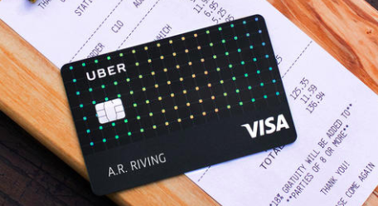
Coalition Card Program - Uber vs Jet Privilege
Earn Points (Cash Back)
2% cash back on Uber rides
4% cash back on dining (Uber eats)
3% cash back on airline tickets, hotels
2% cash back on online spend
Burn points
On Uber platform
Transfer to bank account
Earn Points
Earn JP miles on retail spend
Earn accelerated miles on spend on Jet airways
Burn points
On the platform - Jet Flights + Partner Flights
On a specific catalog maintained at JP website
Value of points - Unknown
Uber’s card is better for the customer than Jet Privilege card as it gives benefits on its platform but also on dining & travel which constitute major share of spending from the card
Notes:
Uber card - https://www.uber.com/newsroom/uber-visa-card/

Slide 93
Uber Card - Economics
 | Economics on the card (per month)
 | Customer 1 | Customer 2 | Customer 3
Monthly Spend on Credit Card | 25,000 | 40,000 | 75,000
Spend on Uber | 5,000 | 5,000 | 8,000
Points Earned on Uber | 100 | 100 | 160
Spend on Food (Uber Eats) | 2,000 | 4,000 | 6,000
Points Earned on Food | 80 | 160 | 240
Spend on Airlines, hotels, etc | 5,000 | 8,000 | 15,000
Points Earned on Airlines,etc | 150 | 240 | 450
Other Spend | 13,000 | 23,000 | 46,000
Points Earned - other | 130 | 230 | 460
Total Points Earned | 460 | 730 | 1,310
Monetary Value of Points | 460 | 730 | 1,310
Earning from Payments @ .5% | 125 | 200 | 375
Breakage of points @ 20% | 92 | 146 | 262
Points redeemed on Uber @ 80% | 368 | 584 | 1,048
Commission on Points redeemed | 74 | 117 | 210
Total Earning | 199 | 317 | 585
Burn is incurred by the partners
Total Burn incurred | 180 | 260 | 400
Net Earnings | 19 | 57 | 185
Revenue Sources -
Earnings from spend on the card
Commission on points redeemed on Uber
Breakage in redemption of points
Cost/ Burn Sources -
Points issues to the customers (just funding Uber points or entire points)
Uber is able to make money by driving acquisitions on the card and without incurring substantial burn

Slide 94
Coalition Program - Next Steps
Coalition Program needs a currency which would be sold to the banks and credited to the customers
Ola Miles - currency to drive these programs needs to be launched

Slide 95
Customer Segment 5 & 6

Slide 96
Airport segment: <9% of customers across non-premium and premium are those who prefer Ola
Segment | Preference | #Users | Rides/ user | GMV/ User | BR | SOW | %Platform rides | %Platform GMV
Segment 5 (Non-Premium) | Prefer-Ola | 27,285 | 3.96 | 1,611 | 18.1 | 85% | 0.4% | 0.7%
 | No preference | 331,279 | 1.98 | 707 | 17.9 | 32% | 2.1% | 3.7%
Segment 6 (Premium) | Prefer-Ola | 9,235 | 3.98 | 1,866 | 22.7 | 85% | 0.1% | 0.3%
 | No preference | 103,053 | 2.00 | 845 | 22.7 | 34% | 0.7% | 1.4%
Opportunity to unlock additional 12 L rides/ month (40k /day) from customers who do not currently prefer Ola
additional GMV/ month - 42 cr

Slide 97
Airport
Segment 5 (Non Premium Users)

Slide 98
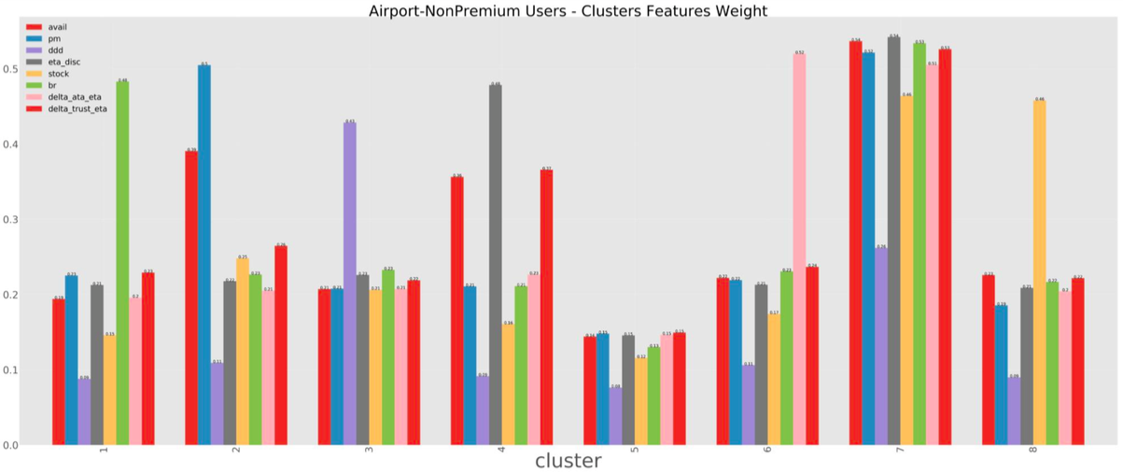
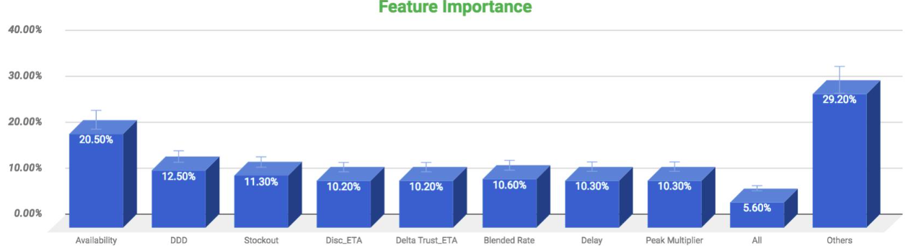
Availability is the most important factor for Non Premium Airport segment

Slide 99
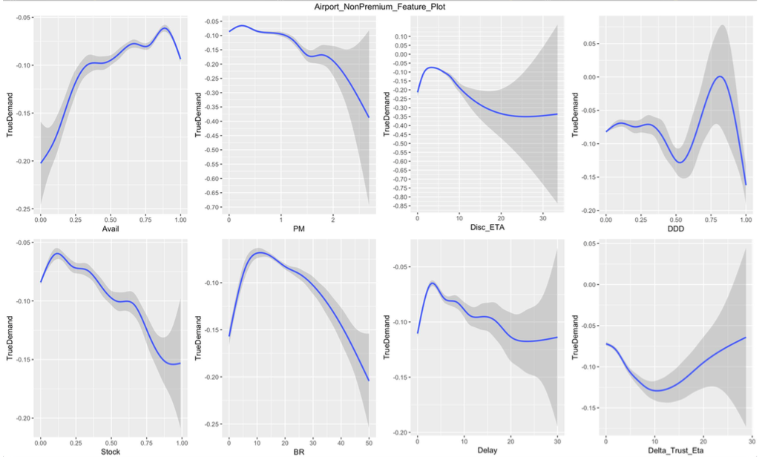
Insights & Patterns on Service levels
Availability < 87% leads to demand fluctuation & disengagement
Peak Multiplier - PM>1.2 leads to disengagement
DDD>35% leads to disengagement (Inconclusive)
Discovery ETA beyond 2 minutes leads to drastic fall in engagement

Slide 100
Insights & Patterns on Service levels
Stock out > 13% leads to disengagement
Delay (ATA - Booking ETA) beyond 3 minutes leads to high level of dis-engagement
BR> 10 leads to decline in true demand & disengagement
Trust factor (ETA booking - Discovery ETA) - (Inconclusive)

Slide 101
Airport Non Premium segment is very sensitive to Blended Rate and has high tolerance towards DD & delay
Category | Metric | Minimum SLA threshold | Minimum SLA threshold (platform) | Desired gap in service level (vs. platform)
Availability | Availability | >87% | >87% | =
 | DDD | <35% | <15% | ~
 | Stockout | <13% | <13% | =
Quality of availability | Discovery ETA | <2 mins | <5 minutes | +3 mins
Pricing | Peak multiplier | <1.2 | <1.2 | =
 | Blended rate | <10 | <10 & <27 | Highly Sensitive
Reliability | Delay | <3 mins | <3 mins & < 8 mins | =
 | Trust | NA | <5 minutes | ~

Slide 102
Airport
Segment 6 (Premium Users)

Slide 103
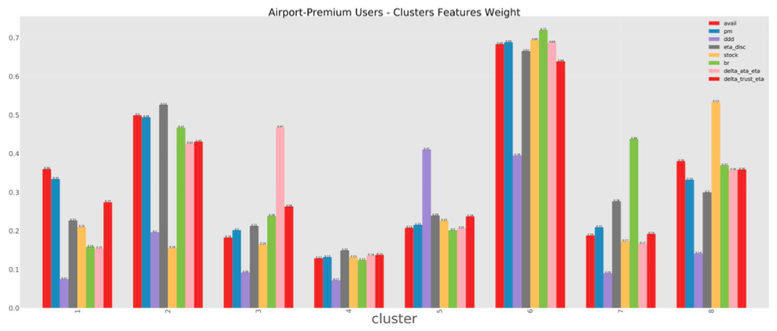
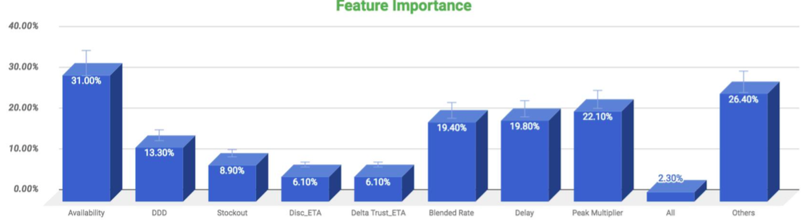
Availability is the most important factor for Premium Airport segment

Slide 104
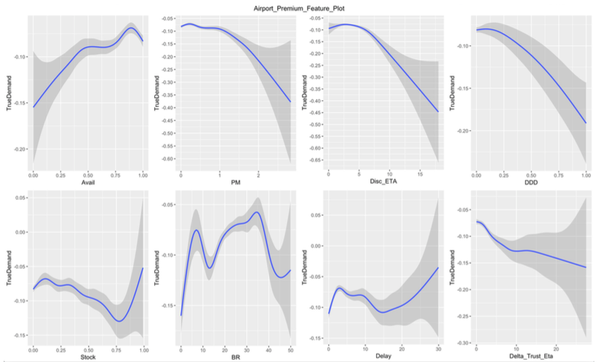
Insights & Patterns on Service levels
Availability < 90% leads to demand fluctuation & disengagement
Peak Multiplier - PM>1.2 leads to disengagement
DDD >10% leads to disengagement Highly Sensitive to it
Discovery ETA - Highly Sensitive beyond 2 mins

Slide 105
Insights & Patterns on Service levels
Stock out > 10% leads to disengagement (Inconclusive)
Delay (ATA - Booking ETA) beyond 3 minutes leads to high level of dis-engagement (Inconclusive)
BR> 8 and >34 leads to decline in true demand & disengagement
Trust factor (ETA booking - Discovery ETA) < 1 min leads to disengagement Highly sensitive to it

Slide 106
Airport Premium segment is very sensitive to delay & DDD
Category | Metric | Minimum SLA threshold | Minimum SLA threshold (platform) | Desired gap in service level (vs. platform)
Availability | Availability | >90% | >87% | =
 | DDD | <10% | <15% | Highly Sensitive
 | Stockout | <10% | <13% | =
Quality of availability | Discovery ETA | <2 mins | <5 minutes | Highly Sensitive
Pricing | Peak multiplier | <1.2 | <1.2 | =
 | Blended rate | <8 and <34 | <10 & <27 | ~
Reliability | Delay | <3 mins | <3 mins & < 8 mins | =
 | Trust | <1 min | <5 minutes | +4 mins

Slide 107
Overall about the segments
S1 - Commute Non Premium segment is very sensitive to delay and Blended rate & is relatively insensitive to DDD
S2 - Commute Premium segment is very sensitive to discovery ETA and delay & has very less tolerance for DDD
S3 - Leisure non premium segment is very sensitive to Blended rate & has very high tolerance for DDD & delay
S4 - Leisure Premium segment is very sensitive to DDD and trust (discovery & booking ETA) and has high spending behaviour to avail better service
S5 - Airport Non Premium segment is very sensitive to Blended Rate and has high tolerance towards DD & delay
S6 - Airport Premium segment is very sensitive to delay & DDD

Slide 108
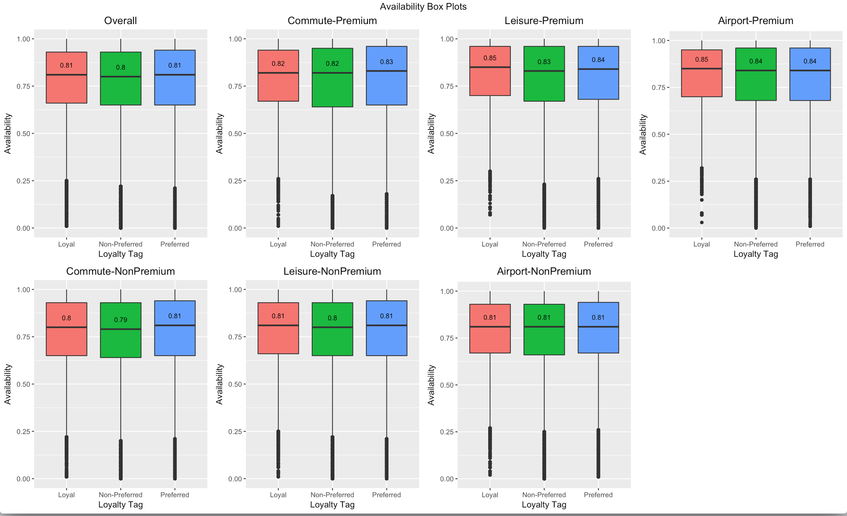
Insights on Availability across customer segments
Loyal customers get a better availability when compared to Preferred and Non-Preferred customers

Slide 109
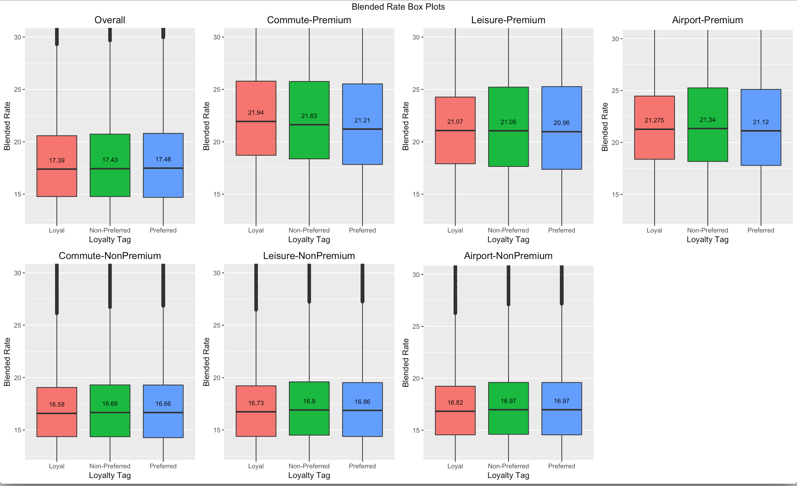
Insights on Blended Rate across customer segments
Loyal customers in the Commute-Premium Segment have Blended Rate comparatively on the higher side
Blended rate is more for the Airport segment compared to other use case segments

Slide 110
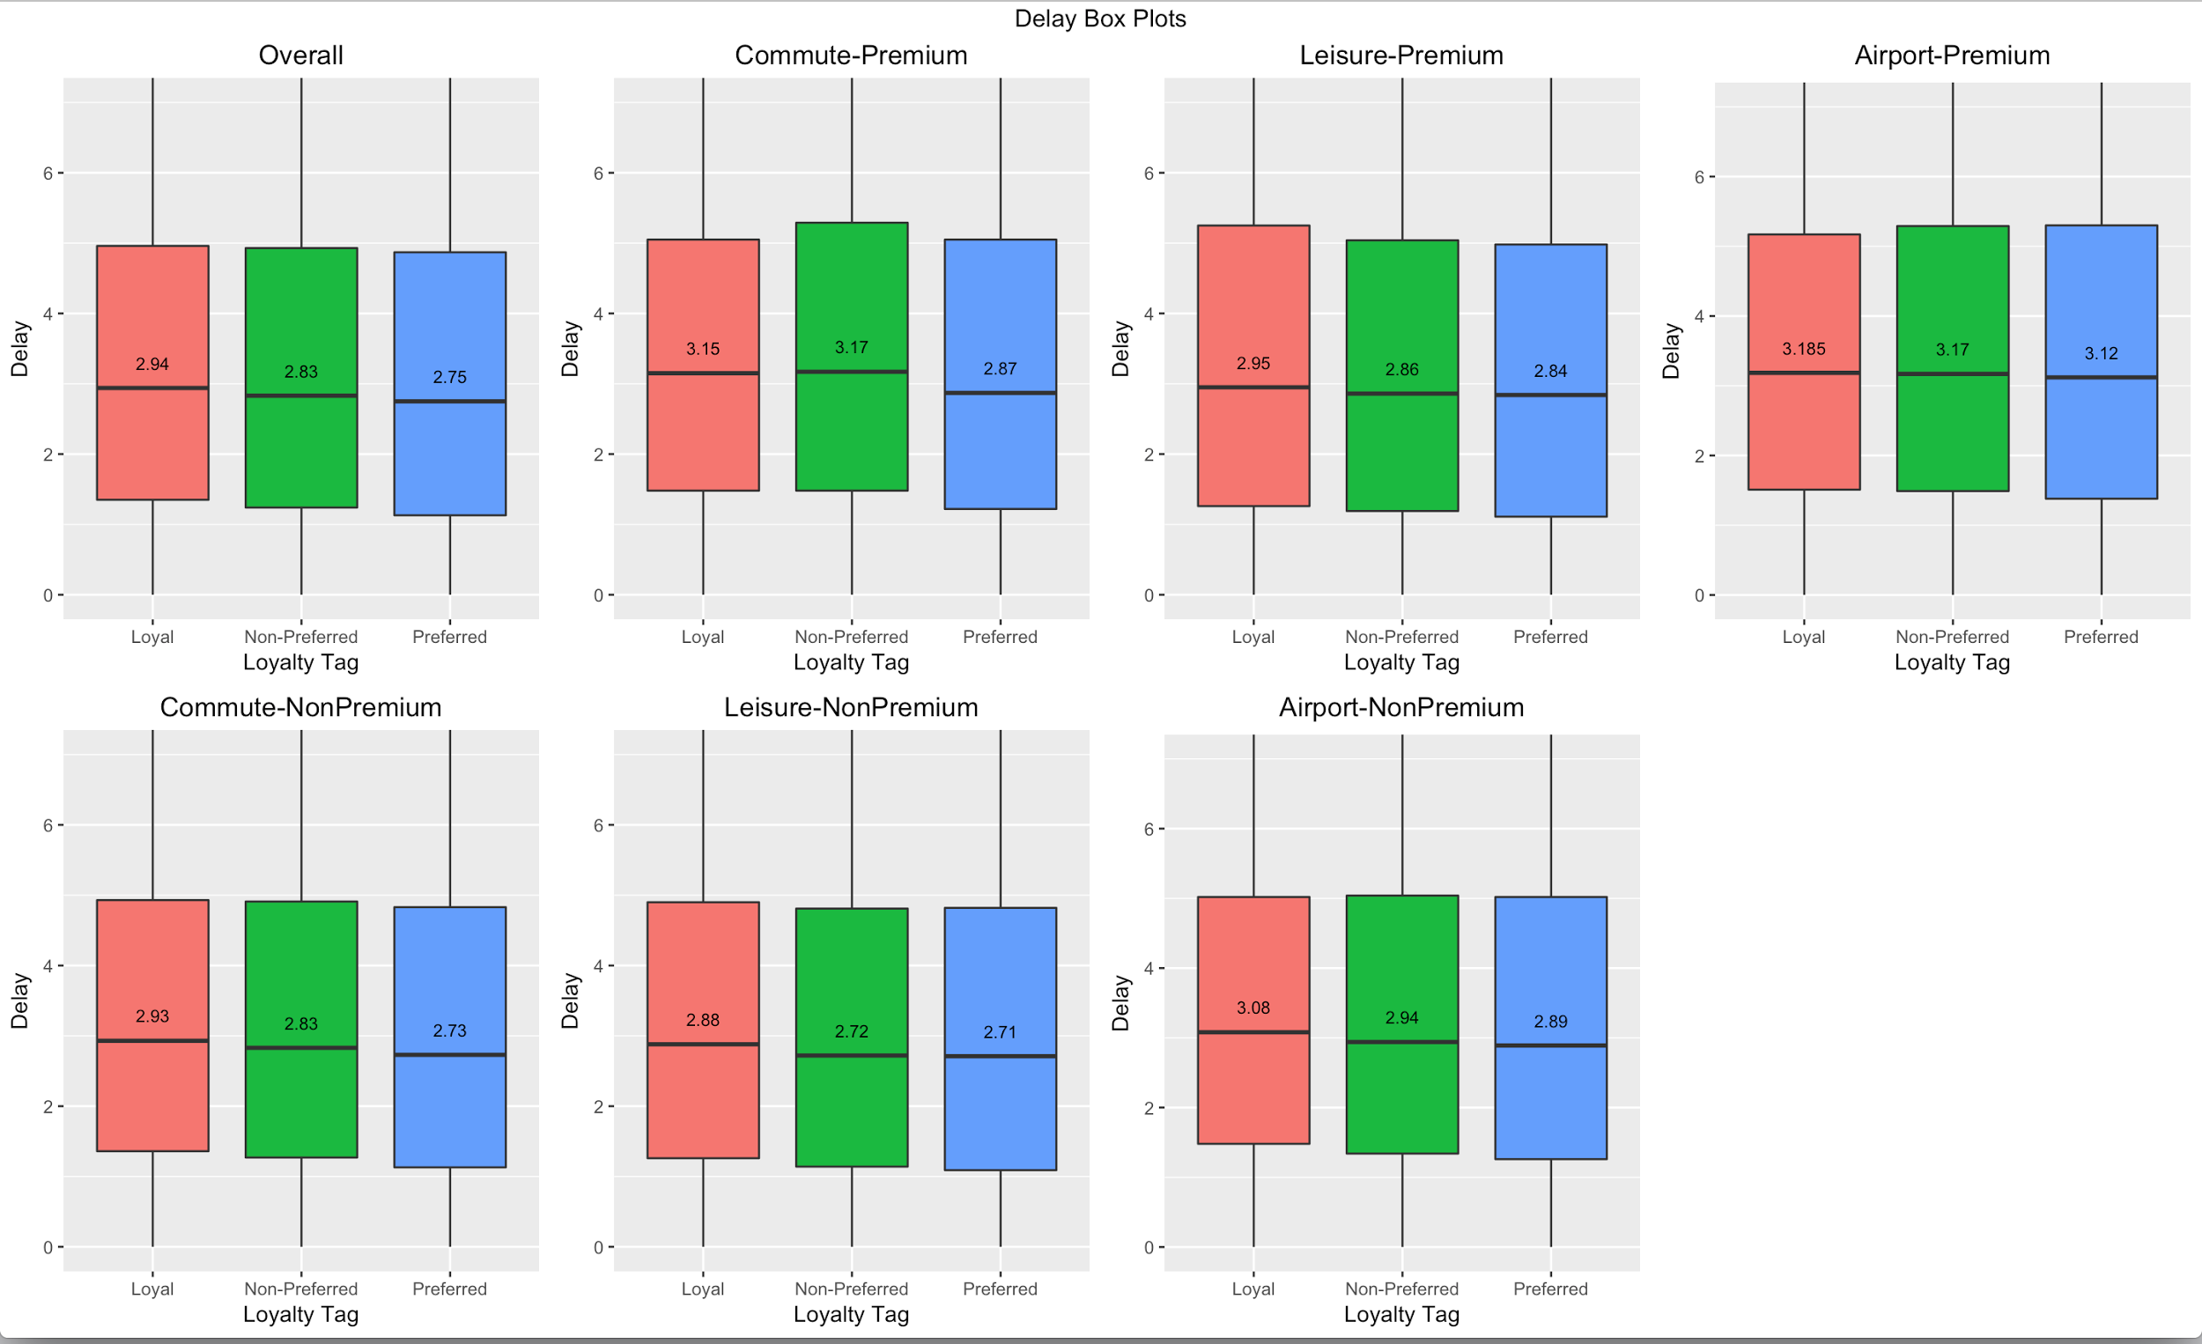
Insights on Delay across customer segments
Preferred customers get comparatively more delay
Delay is on the lower side for the Leisure segments

Slide 111
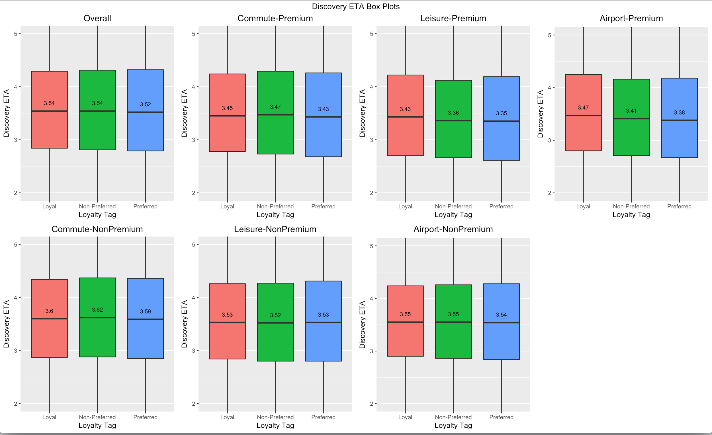
Insights on Discovery ETA across customer segments
Discovery ETA is more for the Non-Premium segments

Slide 112

Insights on Stock-out across customer segments
Median for Stock-out is more for Loyal customers

Slide 113

Insights on Peak Multiplier across customer segments
Peak multiplier is similar across all the segments

Slide 114

Insights on DDD across customer segments
DDD frequency is lesser for the loyal customers

Slide 115

Insights on Delta Trust ETA across customer segments
Delta Trust ETA is lesser for the Leisure segments, as was seen in case of Delay

Slide 116
APPENDIX

Slide 117
Definition of a Potential Loyal customer
Share of Wallet (SOW) - Current LTV/ Potential LTV (in last 6 months)
Conversion - Ratio of ride now to Booking confirmed (in last 6 months)
Customers with rides > 10 & GMV > 2000 in last 6 months have been considered for tagging
SOW Score
Conversion
SOW Score
Conversion
There is no inflection point in SOW & conversion distribution : 75% SOW & 75% conversion threshold

Slide 118



Differential Burn - Grab Taxi
Same earn for users across all tiers - 1 point for $1 spent
Same variable booster across all tiers
Differential burn for each tier - higher tier needs lesser points to get the reward

Slide 119


Differential Earn as well as Burn - Credit Card (Diners Club)
Differential earn for users across all tiers - 5/4/3 points for Rs.150 spent
Same variable booster across all tiers - 10x reward points on all partners
Differential burn for each tier - different value of points for redemption

Slide 120

Differential Earn - Shopper Stop
Differential earn for users across all tiers - 1 point for every Rs.100/ Rs.50/ Rs.34
Extra earn on preferred brands
Similar burn for users across all tiers

Slide 121
Differential burn - Starbucks
Same earn for all customers - 1 start = Rs.300 spent
Differential burn - for Gold customer every 10th drink is free, not valid for a Green customer
Notes:
http://www.starbucks.in/card/rewards

Slide 122
Proposed Loyalty Program - Tiers
Points program - points allocation parameter could be Rides, GMV or Distance travelled
A combination of above metrics can also be used, however it might get complicated for user to understand
Boosters - Users can earn accelerated points during specific hours of day or category or mode of payment
Points can be redeemed on Ola rides, limiting points to be redeemed by time of day or category or mode of payment
Baseline earning of points for each tier - linked with burn that can be incurred for each tier maintaining ENTR neutrality
Rewards & Tier
Tiers - Users get tiered basis rides in last 6 months & get points pre-loaded in their account basis above metric
Tier is revised every 6 months based on points earned in the period
Rewards -
On Ola Platform - Free upgrades, discounted rides, no cancellation fees, Prime@Mini
Outside Ola platform - Points can be redeemed at Partners, hence increasing the perceived value of the points
Notes:
Users will earn points & “Points Balance” will increase as people will earn more points
Users can redeem their points if they are in a favorable tier
Points will get expired after 3 months
Points Earned in last 30 days will be used to allot a tier to a user. Eg. If cutoff for Gold membership is 1000 points & someone earns 1000 points in last 1 month, irrespective of how many they have redeemed, he/she will be made a Gold member
Users will get vouchers as and when their points get redeemed. Automatic redemption will happen (in consideration), and details will be added to invoice

Slide 123
Proposed Loyalty Program - Earning of Points
Parameters | Rides | GMV | Distance
Parameter for earning Points - GMV
GMV is the best metric for earning points, as our commission is linked to it; which is not the case for rides or distance travelled
Earn 10 points for Re.100 spent on Ola
1 point = 10 paise
100 points earned = Re.1 for redemption
Tiers of the program -
NA - Those who are not in any tier (6 months GMV. Rs.2000 & 6 month rides > 10)
Silver, Gold & Platinum
Accelerated points to gamify the construct depending on the tier of the user - to make it a lucrative proposition
Platinum Tier to get additional benefits - preferential availability (on platform) & VAS (outside platform)
Points earned during a period will expire in 6 months
Tier upgrade / downgrade to be reviewed every 6 months - depending on points earned in that period
 | Silver | Gold | Platinum
Points to qualify for tier | 3,000 | 8,000 | 24,000
Priority Availability | NA | NA | Yes
VAS | NA | NA | Yes

Slide 124
Prefcat-Prime - WIP ….
Quantify the features

Slide 125
2. Insights & Patterns on Service levels

Slide 126



2. Insights & Patterns on Service levels

Slide 127
Prefcat-Mini
Quantiy the features

Slide 128
2. Insights & Patterns on Service levels

Slide 129

2. Insights & Patterns on Service levels

Slide 130
How Select & Pass will co-exist
Current Product characteristics - Ola Pass
City Specific benefits
Flat Fare
Current Product characteristics - Ola Select
Peak Waiver
Priority Availability
PAN India
Prime@Mini
VAS - Cleartrip points, Airport lounge access
Select will be an add on to Ola Pass with added benefit - Priority availability tag to increase the delivery on the promise
Scenario 1 -
Add an overall package in Pass - benefits for all flat fare thresholds across km buckets
Break Select into km buckets (as Pass) with other benefits as it is
Users can pay a premium (on top of Pass price) to avail those benefits
Scenario 2 -
Upsell from Pass - by breaking Select into km thresholds
Users can purchase Select benefits by paying a premium
Select program is available as is in current form separately
Notes:
Need to improve this slide

Slide 131
Prefcat-Micro
Quantity the features

Slide 132
2. Insights & Patterns on Service levels

Slide 133

2. Insights & Patterns on Service levels

Slide 134
Projected Scale with the proposed model
Projected Scale
Users - 2.4L
Platform Rides - 1.3L/day(11%)
Micro Rides - 60K/day(20%)
Mini Rides - 40K/day(20%)
Prime - 15K/day(11%)
20% of Mini and Micro rides by March 2018
Notes:
Main success metric is Frequency boost of HF-potential customers

Slide 135
Uber Pass - Subscription Program
Benefits | UberPass India | UberPass Globally* | Select
No Peak Pricing | UberGo | Category Specific | Prime & Mini
Flat Fares | Rs.99 for 10km | $X per ride | -
Benefits Capping | Benefits applicable on rides below 15kms | Yes | None
No Cancellation Fees | Y | NA | -
Prime@Mini fares | - | - | Y
Priority Availability | - | - | Y
Top Drivers | Y | Y | Y
External Benefits | - | - | Airport Lounge Access
Subscription Fees | NA | $20/$30 | 699
Economics | UberPass India | UberPass Globally* | Select
Burn/ride | -50 | NA | -45
Subs fee/ ride | 0 | NA | +24
Growth Revenue/ ride* | +10 | NA | +10
Net cost per ride | -40 | NA | -11
Net cost per customer/month | -800 | NA | -220
Uber has a Subscription based loyalty program globally called UberPass/VIP
In India Uber has launched the same at Zero Subscription Price and incurring a burn of Rs50/ride currently
*Link to UberPass
Notes:
Add the point that globally Uber Pass has a subscription fee, hence effectively it is a subscription program with an entry fee of zero for now in India

Slide 136
Ola Pass
Program Construct
Buy a package specific to a preferred km bucket
Pay Flat fare upto threshold km limit (of that bucket) & standard category fare post limit
Applicable on Micro, Mini & Prime rides
How it will drive loyalty on Ola Platform
Drive loyalty of solo rides, as done by share pass for Share riders
As customers buy subscription for commute, and results in taking other rides as well - thus decreasing window shopping & increasing Share of wallet on Ola platform
Status
Pilot launched in Bangalore & Mumbai for 10k customers in each city

Slide 137
Subscription programs have been successful in driving loyalty among commute segment, however, penetration remains limited due to upfront payment (1/ 2)
 | Loyal
Pref Cat | #Users | SOW | %Select | Select Users | Potential | %Share Pass | Share Pass users | Potential
Auto | 13,346 | 86.0% | 1.70% | 230 | 37.4 | 3.90% | 515 | 35.4
Micro | 63,060 | 87.0% | 2.90% | 1,819 | 32.5 | 3.50% | 2,207 | 28.2
Mini | 30,529 | 87.0% | 3.90% | 1,192 | 30.4 | 2.30% | 712 | 27.1
Prime | 19,655 | 87.0% | 19.90% | 3,908 | 36.6 | 3.80% | 739 | 35.9
Share | 35,669 | 86.0% | 2.80% | 1,000 | 33.8 | 32.70% | 11,672 | 29.2
 | Non-Loyal
Pref Cat | #Users | SOW | %Select | Select Users | Potential | %Share Pass | Share Pass users | Potential
Auto | 55,659 | 45.00% | 0.80% | 457 | 43.4 | 3.20% | 1,760 | 43.9
Micro | 263,860 | 43.00% | 1.10% | 2,926 | 32.0 | 3.30% | 8,782 | 33.5
Mini | 118,842 | 44.00% | 1.80% | 2,169 | 29.9 | 2.30% | 2,774 | 31.7
Prime | 73,117 | 45.00% | 11.40% | 8,311 | 34.5 | 3.20% | 2,350 | 36.3
Share | 201,102 | 35.00% | 1.20% | 2,349 | 47.2 | 31.10% | 62,588 | 54.1
Non-Loyal users are high potential users - High Opportunity

Slide 138
Subscription programs have been successful in driving loyalty among commute segment, however, penetration remains limited due to upfront payment (2/ 2)
Subscription program leads to increase in GMV & rides across all use cases
Select
Use Case | Pre Rides | Post Rides | %Change
Commute | 3.8 | 6.3 | 65%
To Airport | 0.4 | 0.9 | 101%
From Airport | 0.4 | 0.8 | 104%
Others | 5.2 | 8.2 | 59%
Total Rides | 9.8 | 16.2 | 65%
Share Pass
Use Case | Pre Rides | Post Rides | %Change
Commute | 3.4 | 6.1 | 77%
To Airport | 0.1 | 0.1 | 78%
From Airport | 0.1 | 0.2 | 90%
Others | 2.2 | 4.3 | 93%
Total Rides | 5.8 | 10.7 | 84%
Select
Use Case | Pre Gmv | Post Gmv | %Change
Commute | 1,227 | 2,155 | 76%
To Airport | 435 | 882 | 103%
From Airport | 484 | 999 | 107%
Others | 1,217 | 1,982 | 63%
Total Rides | 956 | 1,663 | 74%
Sharepass
Use Case | Pre Gmv | Post Gmv | %Change
Commute | 790 | 1,302 | 65%
To Airport | 158 | 256 | 62%
From Airport | 160 | 268 | 67%
Others | 425 | 789 | 86%
Total Rides | 516 | 897 | 74%

Slide 139
Segmentation of users - Premium vs Non Premium
 | Count of users |  | %Rides |  | %GMV |  | SOW |  | BR
Use Case | Premium | Non Premium | Premium | Non Premium | Premium | Non Premium | Premium | Non Premium | Premium | Non Premium
Commute | 112,220 | 767,643 | 33.30% | 36.70% | 22.80% | 27.60% | 54.20% | 50.00% | 23.5 | 14.1
To airport | 71,075 | 298,559 | 5.90% | 3.20% | 10.50% | 6.60% | 56.40% | 55.00% | 20.6 | 17.4
From airport | 63,603 | 248,022 | 5.60% | 2.80% | 11.90% | 6.20% | 57.60% | 55.80% | 24.3 | 19.3
Other | 239,420 | 1,580,723 | 55.20% | 57.30% | 54.80% | 59.60% | 55.80% | 51.40% | 21.9 | 15.9
Total | 313,093 | 1,900,050 |  |  |  |  | 56.00% | 53.06% | 22.4 | 15.6
Commute Opportunity : 38L rides/ month (1.3L/day) & additional GMV/ month - 50 cr
Leisure Opportunity : 58L rides/ month (1.9L/day) & additional GMV/ month - 110 cr

Slide 140
Use Case X User Segments Loyalty View
 | Count of users |  | %Rides |  | %GMV
Use Case | Loyal | Non Loyal | Loyal | Non Loyal | Loyal | Non Loyal
Commute | 165,042 | 715,361 | 6.3% | 15.7% | 6.6% | 12.9%
To airport | 92,500 | 277,360 | 0.6% | 1.5% | 1.6% | 3.5%
From airport | 80,842 | 230,981 | 0.6% | 1.3% | 1.7% | 3.4%
Leisure | 301,172 | 1,519,827 | 9.2% | 25.5% | 12.7% | 29.9%
Total | 322,842 | 1,891,396 | 17% | 44% | 23% | 50%
 | Avg SOW
Use Case | Loyal | Non Loyal
Commute | 86.4% | 39.1%
To airport | 86.5% | 43.2%
From airport | 86.5% | 43.8%
Leisure | 86.5% | 40.1%
Blended Rate
Loyal | Non Loyal
16.1 | 14.3
18.2 | 17.9
20.6 | 20.2
17.1 | 16.3
Commute Opportunity : 38L rides/ month (1.3L/day) & additional GMV/ month - 50 cr
Leisure Opportunity : 58L rides/ month (1.9L/day) & additional GMV/ month - 110 cr

Slide 141
Segment 2 - Leisure
Loyal
Non-Loyal
 | %Users | Rides/User | GMV/User | BR | SOW
Auto | 5,410 | 15.1 | 2,250 | 15.6 | 86%
Micro | 57,839 | 10.7 | 2,751 | 17.4 | 86%
Mini | 35,997 | 10.1 | 2,809 | 18.7 | 86%
Prime | 21,498 | 11.1 | 3,667 | 19.8 | 86%
Share | 28,134 | 11.0 | 2,177 | 15.1 | 86%
%Users | Rides/User | GMV/User | BR | SOW
36,691 | 6.9 | 854 | 15.2 | 41%
387,654 | 4.7 | 1,034 | 16.9 | 40%
225,415 | 4.5 | 1,082 | 18.4 | 41%
134,220 | 5.0 | 1,392 | 19.6 | 41%
185,868 | 6.1 | 930 | 13.5 | 35%
Total users in segments 1 - 11.2 L
Loyals - 1.5 L
Non Loyals - 9.7 L
Opportunity to unlock additional 44L rides/ month (1.5L/day) from Non Loyal customers
additional GMV/ month - 93 cr

Slide 142
Subscription program can’t drive loyalty for this segments where leisure is the only use case (no planned rides), hence Earned Loyalty Program to be launched
 | Loyal
Pref Cat | #Users | SOW | %Select | Select Users | Potential | %Share Pass | Share Pass users | Potential
Auto | 5,410 | 86.2% | 0.8% | 43 | 30.2 | 2.1% | 111 | 26.9
Micro | 57,839 | 86.4% | 1.4% | 810 | 25.6 | 2.7% | 1,568 | 21.1
Mini | 35,997 | 86.4% | 1.8% | 657 | 23.5 | 1.6% | 582 | 20.2
Prime | 21,498 | 86.3% | 8.8% | 1,896 | 26.7 | 2.2% | 472 | 26.1
Share | 28,134 | 86.4% | 1.5% | 426 | 26.8 | 16.9% | 4,763 | 20.6
 | Non-Loyal
Pref Cat | #Users | SOW | %Select | Select Users | Potential | %Share Pass | Share Pass users | Potential
Auto | 36,691 | 40.7% | 0.3% | 103 | 28.0 | 1.7% | 626 | 26.6
Micro | 387,654 | 40.2% | 0.6% | 2,187 | 22.4 | 2.2% | 8,693 | 21.4
Mini | 225,415 | 40.9% | 0.8% | 1,906 | 21.7 | 1.5% | 3,325 | 19.4
Prime | 134,220 | 41.2% | 5.1% | 6,817 | 24.5 | 1.9% | 2,544 | 23.0
Share | 185,868 | 34.5% | 0.6% | 1,116 | 32.6 | 15.8% | 29,429 | 30.2
Non-Loyal users are high potential users - High Opportunity

Slide 143
Segment 3 - Airport
Loyal
Non-Loyal
 | %Users | Rides/User | GMV/User | BR | SOW
Auto | 4,457 | 20.5 | 2,930 | 16.0 | 87.0%
Micro | 40,789 | 13.3 | 3,464 | 17.6 | 87.0%
Mini | 25,327 | 12.2 | 3,519 | 19.0 | 87.0%
Prime | 19,929 | 14.6 | 4,717 | 20.0 | 86.0%
Share | 21,426 | 15.3 | 2,944 | 14.9 | 87.0%
%Users | Rides/User | GMV/User | BR | SOW
10,784 | 12.7 | 1,730 | 15.9 | 50.0%
133,534 | 7.3 | 1,817 | 17.4 | 47.0%
85,221 | 6.7 | 1,874 | 19.0 | 47.0%
68,958 | 7.6 | 2,392 | 20.2 | 47.0%
68,001 | 11.2 | 1,793 | 13.6 | 42.0%
Total users in segments 1 - 4.8 L
Loyals - 1.1 L
Non Loyals - 3.7 L
Opportunity to unlock additional 18 L rides/ month (60k /day) from Non Loyal customers
additional GMV/ month - 44 cr

Slide 144
Segment 1 - Commute + Leisure
Hypothesis - Discount on commute rides leads to lock in and thus higher value extraction on leisure rides
Subscription program leads to increase in rides across all use cases
Select
Use Case | Pre Rides | Post Rides | %Change
Commute | 3.8 | 6.3 | 65%
To Airport | 0.4 | 0.9 | 101%
From Airport | 0.4 | 0.8 | 104%
Others | 5.2 | 8.2 | 59%
Total Rides | 9.8 | 16.2 | 65%
Share Pass
Use Case | Pre Rides | Post Rides | %Change
Commute | 3.4 | 6.1 | 77%
To Airport | 0.1 | 0.1 | 78%
From Airport | 0.1 | 0.2 | 90%
Others | 2.2 | 4.3 | 93%
Total Rides | 5.8 | 10.7 | 84%
Segment | SOW | #Users | Select | Share Pass | %Select | %Share Pass
Premium | Loyal | 45,438 | 4,160 | 544 | 9.2% | 1.2%
Premium | Non Loyal | 219,652 | 10,582 | 2,366 | 4.8% | 1.1%
Non-Premium | Loyal | 265,609 | 9,502 | 22,795 | 3.6% | 8.6%
Non-Premium | Non Loyal | 1,462,013 | 23,456 | 120,532 | 1.6% | 8.2%

Slide 145


DS - Premium (define personas)
Need to find out if there is any specific requirement of Premium vs Non Premium Users

Slide 146


DS - Non Premium (define personas)
Need to find out if there is any specific requirement of Premium vs Non Premium Users

Slide 147

DS - Premium vs Non Premium (define personas)
Availability & DDD are key features where difference can be observed Premium vs Non Premium

Slide 148


DS - Loyal vs Non Loyal(define personas)
Need to find out if there is any specific requirement of Loyal vs Non Loyal Users

Slide 149


DS - Loyal vs Non Loyal (define personas)
Need to find out if there is any specific requirement of Loyal vs Non Loyal Users

Slide 150

DS - Loyal vs Non Loyal (define personas)
Loyal Users have a continuous dis-engagement with increasing Discovery Eta [> 5 mins]

Slide 152

Findings from DS - Commute
Findings -
Delay (Booking ETA vs Actual ATA) is the biggest factor here - leading to customer dissatisfaction and hence decrease in engagement on the platform

Slide 153
Findings from DS - Commute
Commute |  |  | Commute-Loyal |  |  | Commute-NonLoyal
Feature | %Users |  | Feature | %Users |  | Feature | %Users
None | 25% |  | None | 25% |  | None | 26%
Delay+Blended Rate | 5% |  | Delay+Blended Rate | 5% |  | Delay+Blended Rate | 5%
Peak_Multiplier+Availability | 5% |  | Trust_Eta+Peak_Multiplier | 5% |  | Peak_Multiplier+Availability | 5%
Trust_Eta+Delay | 4% |  | Delay+Peak_Multiplier | 5% |  | Trust_Eta+Delay | 4%
Trust_Eta+Blended Rate | 4% |  | Peak_Multiplier+Availability | 5% |  | Trust_Eta+Blended Rate | 4%
Trust_Eta+Delay+Blended Rate | 4% |  | Trust_Eta+Delay | 4% |  | Trust_Eta+Delay+Blended Rate | 4%
Trust_Eta+Peak_Multiplier | 4% |  | Trust_Eta+Blended Rate | 4% |  | Trust_Eta+Peak_Multiplier | 4%
Delay+Peak_Multiplier | 4% |  | Blended Rate+Peak_Multiplier | 4% |  | Delay+Peak_Multiplier | 4%
Blended Rate+Peak_Multiplier | 4% |  | Delay+Availability | 4% |  | Blended Rate+Peak_Multiplier | 4%
Delay+Availability | 4% |  | Trust_Eta+Delay+Blended Rate | 3% |  | Delay+Availability | 4%
Delay+Blended Rate+Peak_Multiplier | 3% |  | Delay+Blended Rate+Peak_Multiplier | 3% |  | Delay+Blended Rate+Peak_Multiplier | 3%
Feature sensitivity ranked as below (high to low) for commute users:
Delay: ~25%
Blended Rate: ~20%
ETA Promise/Trust: ~16%

Slide 154

Findings from DS- Airport

Slide 155
Findings from DS- Airport
Airport |  |  | Airport-Loyal |  |  | Airport-NonLoyal
Feature | %Users |  | Feature | %Users |  | Feature | %Users
None | 15% |  | None | 13% |  | None | 14%
Delay+Availability | 10% |  | Delay+Availability | 11% |  | Delay+Availability | 11%
Availability | 9% |  | Availability | 10% |  | Availability | 10%
Trust_Eta+Delay+Blended Rate | 7% |  | Trust_Eta+Delay+Blended Rate | 7% |  | Trust_Eta+Delay+Blended Rate | 7%
Trust_Eta+Peak_Multiplier | 7% |  | Trust_Eta+Peak_Multiplier | 6% |  | Trust_Eta+Peak_Multiplier | 6%
Delay+Peak_Multiplier | 6% |  | Trust_Eta+Availability | 6% |  | Trust_Eta+Availability | 6%
Trust_Eta+Availability | 6% |  | Delay+Peak_Multiplier | 5% |  | Delay+Peak_Multiplier | 5%
Trust_Eta+Delay | 4% |  | Delay+Blended Rate+Peak_Multiplier | 5% |  | Delay+Blended Rate+Peak_Multiplier | 5%
Delay+Blended Rate+Peak_Multiplier | 4% |  | Trust_Eta | 4% |  | Trust_Eta | 4%
Trust_Eta | 3% |  | Delay | 4% |  | Delay | 4%
Delay | 3% |  | Trust_Eta+Delay | 4% |  | Trust_Eta+Delay | 4%
Feature sensitivity ranked as below (high to low) for Airport users:
Delay: 35%
ETA Promise/Trust: ~27%
Availability: ~25%

Slide 156
Insights & Patterns on Service levels
OverAll |  |  | Loyal |  |  | Non Loyal
Feature | %Users |  | Feature | %Users |  | Feature | %Users
None | 25% |  | None | 25% |  | None | 25%
Delay+Blended Rate | 5% |  | Trust_Eta+Delay | 5% |  | Delay+Blended Rate | 5%
Peak_Multiplier+Availability | 5% |  | Delay+Blended Rate | 5% |  | Peak_Multiplier+Availability | 5%
Trust_Eta+Delay | 4% |  | Trust_Eta+Peak_Multiplier | 5% |  | Trust_Eta+Delay | 4%
Trust_Eta+Blended Rate | 4% |  | Delay+Peak_Multiplier | 5% |  | Trust_Eta+Blended Rate | 4%
Trust_Eta+Delay+Blended Rate | 4% |  | Peak_Multiplier+Availability | 5% |  | Trust_Eta+Delay+Blended Rate | 4%
Trust_Eta+Peak_Multiplier | 4% |  | Blended Rate+Peak_Multiplier | 4% |  | Trust_Eta+Peak_Multiplier | 4%
Delay+Peak_Multiplier | 4% |  | Delay+Availability | 4% |  | Delay+Peak_Multiplier | 4%
Blended Rate+Peak_Multiplier | 4% |  | Trust_Eta+Blended Rate | 3% |  | Blended Rate+Peak_Multiplier | 4%
Delay+Availability | 4% |  | Trust_Eta+Delay+Blended Rate | 3% |  | Delay+Availability | 4%
Delay+Blended Rate+Peak_Multiplier | 3% |  | Delay+Blended Rate+Peak_Multiplier | 3% |  | Delay+Blended Rate+Peak_Multiplier | 3%
Feature sensitivity ranked as below (high to low) on an overall level:
Delay: ~25%
Blended Rate: ~20%
ETA Promise/Trust: ~15%

Slide 157
Subscription programs have been successful in driving loyalty among commute segment, however, penetration remains limited due to upfront payment
 | Loyal |  |  |  |  | Non-Loyal
 | #Users | SOW | %Select | %Share Pass |  | #Users | SOW | %Select | %Share Pass
Pref Cat
Auto | 13,346 | 86.0% | 1.7% | 3.9% |  | 55,659 | 45.0% | 0.8% | 3.2%
Micro | 63,060 | 87.0% | 2.9% | 3.5% |  | 263,860 | 43.0% | 1.1% | 3.3%
Mini | 30,529 | 87.0% | 3.9% | 2.3% |  | 118,842 | 44.0% | 1.8% | 2.3%
Prime | 19,655 | 87.0% | 19.9% | 3.8% |  | 73,117 | 45.0% | 11.4% | 3.2%
Share | 35,669 | 86.0% | 2.8% | 32.7% |  | 201,102 | 35.0% | 1.2% | 31.1%
Non-Loyal users are high potential users - High Opportunity
Select | Rides/User | GMV/User | ATS | SOW
Loyal | 29.9 | 7,127 | 238 | 87%
Non Loyal | 18.0 | 3,926 | 221 | 51% | 35.4
Share Pass | Rides/User | GMV/User | ATS | SOW
Loyal | 25.5 | 3,944.5 | 155 | 86%
Non Loyal | 18.2 | 2,099.5 | 117 | 37% | 49.5
Subscription program leads to increase in rides across all use cases
Select
Use Case | Pre Rides | Post Rides | %Change
Commute | 3.8 | 6.3 | 65%
To Airport | 0.4 | 0.9 | 101%
From Airport | 0.4 | 0.8 | 104%
Others | 5.2 | 8.2 | 59%
Total Rides | 9.8 | 16.2 | 65%
Share Pass
Use Case | Pre Rides | Post Rides | %Change
Commute | 3.4 | 6.1 | 77%
To Airport | 0.1 | 0.1 | 78%
From Airport | 0.1 | 0.2 | 90%
Others | 2.2 | 4.3 | 93%
Total Rides | 5.8 | 10.7 | 84%

Slide 158
All commuters use Ola for leisure, but only leisure is the biggest segment
There are 3 broad segments of users -
Only Leisure
Commute + Leisure
Airport
Commute | To_Airport | From_Airport | Other | Loyal | Non-Loyal | Loyal | Non-Loyal
1 | 1 | 1 | 1 | 5% | 2% | 17,039 | 27,952
1 | 1 | 0 | 1 | 4% | 2% | 13,633 | 34,459
1 | 0 | 1 | 1 | 2% | 1% | 7,913 | 20,317
1 | 0 | 0 | 1 | 35% | 27% | 111,919 | 464,474
1 | 1 | 1 | 0 | 1% | 0% | 1,729 | 5,252
1 | 1 | 0 | 0 | 0% | 0% | 1,327 | 8,216
1 | 0 | 1 | 0 | 0% | 0% | 805 | 4,894
1 | 0 | 0 | 0 | 3% | 9% | 10,677 | 149,797
0 | 1 | 1 | 1 | 12% | 5% | 37,774 | 86,930
0 | 1 | 0 | 1 | 5% | 4% | 17,088 | 74,671
0 | 0 | 1 | 1 | 4% | 3% | 11,685 | 50,555
0 | 0 | 0 | 1 | 26% | 44% | 84,121 | 760,469
0 | 1 | 1 | 0 | 1% | 1% | 3,121 | 19,320
0 | 1 | 0 | 0 | 0% | 1% | 789 | 20,560
0 | 0 | 1 | 0 | 0% | 1% | 776 | 15,761
Add venn diagram for this

Slide 159

Findings from DS- Leisure

Slide 160
Findings from DS- Leisure
Leisure |  |  | Leisure-Loyal |  |  | Leisure-NonLoyal
Feature | %Users |  | Feature | %Users |  | Feature | %Users
None | 25% |  | None | 26% |  | None | 25%
Trust_Eta+Delay | 5% |  | Trust_Eta+Delay | 5% |  | Trust_Eta+Delay | 5%
Delay+Blended Rate | 5% |  | Delay+Blended Rate | 5% |  | Delay+Blended Rate | 5%
Peak_Multiplier+Availability | 5% |  | Trust_Eta+Peak_Multiplier | 5% |  | Peak_Multiplier+Availability | 5%
Trust_Eta+Blended Rate | 4% |  | Delay+Peak_Multiplier | 5% |  | Trust_Eta+Blended Rate | 4%
Trust_Eta+Delay+Blended Rate | 4% |  | Peak_Multiplier+Availability | 5% |  | Trust_Eta+Delay+Blended Rate | 4%
Trust_Eta+Peak_Multiplier | 4% |  | Blended Rate+Peak_Multiplier | 4% |  | Trust_Eta+Peak_Multiplier | 4%
Delay+Peak_Multiplier | 4% |  | Delay+Availability | 4% |  | Delay+Peak_Multiplier | 4%
Blended Rate+Peak_Multiplier | 4% |  | Trust_Eta+Blended Rate | 3% |  | Blended Rate+Peak_Multiplier | 4%
Delay+Availability | 4% |  | Trust_Eta+Delay+Blended Rate | 3% |  | Delay+Availability | 4%
Delay+Blended Rate+Peak_Multiplier | 3% |  | Delay+Blended Rate+Peak_Multiplier | 3% |  | Delay+Blended Rate+Peak_Multiplier | 3%
ETA and ATA prominent feature for Leisure rides

Slide 161
Types of Loyalty Programs
Subscription Program (Amazon Prime)
Typically paid program
Pros
Effective loyalty tool among HF customers
Captures major majority share of wallet from HF customers
Should have a strong Value Prop and attractive Pricing to drive purchase
Cons
Price of subscription is very critical and may result profitability at a certain scale
Earned loyalty Program (Credit Cards, Jet Privilege, Starbucks etc)
Typically reward points/miles program having tiers with accelerated earn/burn rates
Pros
Increases share of wallet among MF customers due to incentivizing structure of the program
Increases repeat usage among LF customers as they will have unused points
First time users would see immense value in this programme
Cons
Most traditional way of driving loyalty
Incurs certain burn on every transaction which can only be compensated by
Growth revenue and Reduced marketing spends
Notes:
Simplify and keep only a definition of both

Slide 162
Subscription Program
Global
Amazon Prime
Indian
Amazon Prime India

Slide 163
Proposed Loyalty Program (WIP)
Point System - Users will amass points based on their activity. With points, users can start amassing points right from their first ride, hence it will attract all types of users, especially commuters who have regular need for cabs.
Tiering of the program -
Users will earn points based on their total bill size. “Points Balance” will increase as people will earn more points
Users can redeem their points if they are in a favorable tier. The total points redeemed will be categorised as “Points Redeemed”
Points will get expired after 3 months
Points Earned = Points Redeemed + Points Balance (for that month)
Points Earned in last 30 days will be used to allot a tier to a user. Eg. If cutoff for Gold membership is 1000 points & someone earns 1000 points in last 1 month, irrespective of how many they have redeemed, he/she will be made a Gold member
When this programme is rolled out, users will be automatically allocated points based on last month history
Users will get vouchers as and when their points get redeemed. Automatic redemption will happen (in consideration), and details will be added to invoice

Slide 164
Amazon Prime
Estimated 65+ mn paid members globally
$99/year after 30 day trial
After paying this customers will not shop anywhere
BENEFITS
Unlimited Free Shipping
Free 2 day shipping with no minimum order size
Promotional credit for choosing No-rush delivery
Ability to share benefits with up to 4 other family members
Free Digital content
Unlimited streaming and downloads of movies, music
Access to e-books
One free kindle e-book to borrow each month
Other benefits
Early access to Amazon deals
Access to Prime pantry, Prime Now(one hour delivery)
INSIGHTS
Prime members spend estimated 4X what non prime members spend
Customers spend ~40% more after joining prime
Estimate : 10% of the Amazon base is Prime
Back

Slide 165

What worked for Amazon Prime ?
The average shopping cart abandonment rate for eCommerce websites is 67.91% which is mainly due to delivery charges and high taxes
Amazon understood this part of shopper psyche and came up with a solution called Prime

Slide 166
JetPrivilege
Earn Points
Earn JP miles on retail spend
Earn accelerated miles on spend on Jet airways
Burn points
On the platform - Jet Flights + Partner Flights
On a specific catalog maintained at JP website
Value of points - Unknown
Jet Airways exclusive card is promoting spend on jet platform by giving accelerated points and burn exclusively on its platform

Slide 167
Amazon Prime India
Launched in July’16
Estimated 20 Mn members India(paid + free)
Rs 499/year after 30 day trial

Slide 168
Earned Loyalty Program
Global
Starbucks
Indian
Jet Privilige
Goibibo Go Cash
Mobikwik SuperCash

Slide 169
Starbucks
1 purchase of min Rs 300 = 1 star
EARNING POINTS
Customer earns 1 star for every purchase done at Starbucks
Stars can also be earned on products sold outside retail locations (eg. Tea, coffee beans etc.)
Stars can be earned through purchases made on other platforms such as Lyft and Spotify
Additional rewards through referral programs
Intangible benefits such as tailored communication, pre-ordering facilities, store locators etc.
Level | Criteria | Benefits
Welcome Level | Registration | Free birthday beverage
Green Level | 5 Stars within a year | Free refills of brewed coffee or tea, a free beverage on buying whole bean coffee etc.
Gold level | 30 stars within a year | Free drink for every 15 stars and customized offers and coupons
Unlocking and staying in the tier driver repurchase for Starbucks

Slide 170

Amex - JP Miles Co-branded Card
How is it profitable for Jet?
Debit/Credit Cards companies buy miles in advance from Jet to issue to customers
Revenue 1 - Gross margin on points
Revenue 2 - Breakage on points not redeemed
Revenue sharing on spends
Revenue 3 - As JP Card has strong appeal and is also sold on Jet Platform, DC/CC companies share certain percentage of revenue with Jet on all spends
Cost 1 - Jet issues accelerated miles on spends from Co-branded card on its platform

Slide 171
JetPrivilege
Earn points basis tiers
Spending on the platform - Flights, Hotels
Buy points directly at a discount
Burn other CC/DC loyalty points to buy JP Miles
Burn points
On the platform - Jet Flights + Partner Flights
On a specific catalog maintained at JP website
Co-branded Cards
Co branded HDFC card, followed by Amex, Citi etc
Buy JP Miles from CC/DC points redemption catalog
Co-branded Cards has a multiplying effect both for profitability and loyalty
Similar practice is a very successful business model used by all major airlines - reference article
Delta Airlines has tied up with Lyft to issue miles on spends made on Lyft - reference article

Slide 172

Goibibo - Go Cash
Both earn and burn allowed on a single transaction
Earn points on the platform by -
Transacting on the platform
Signing up
Referring friends
Burn points on the platform
% of GMV of transaction
Expiry - 3-6 months
Earn and burn restricted only on the platform, but allowed on every transaction
Goibibo gives so much earn that customers always have GoCash that drives repurchase

Slide 173


MobiKwik - Super Cash
Either of earn or burn allowed on a single transaction
Earn Points
By using MK at a partner merchant, if offer is running
Earn value = offer value
Burn Points
By using MK at a partner merchant, if offer is running
Burn value = %of Supercash as per offer
Expiry - 45 days
Earn or burn allowed depending on offer running on the merchant,
a really successful tool to drive repeat txns for MobiKwik

Slide 174


Snapdeal - Co-branded Card (HDFC)
Earn points -
2 reward points on every Rs.150 spends
10x reward points on spend on Snapdeal, Urbanclap & ticketnew
Burn Points -
Only on Snapdeal
1 point = Rs 0.50
Other benefits -
10% discount on snapdeal every Friday
5% discount on Snapdeal on rest of the days
1% fuel surcharge waiver

Slide 175
Competition Overview

Slide 176
Uber Pass India - 2 Constructs
Construct 1
Take X rides to unlock Uber Pass for Y rides
Take Y Uber Pass rides in one week to stay in the Uber VIP club
Communication- Dear Rider, you're almost there! Take 5 uberGO rides between Mon-Fri, and unlock the VIP view next week - no surge or subscription fees, pay flat Rs.100 or lesser upto 10 kms on uberGO rides in Chennai (6AM to 6PM).
Construct 2
Free Trial to UHF customers, with earned loyalty to stay in program
Take Y Uber Pass rides in one week to stay in the Uber VIP club
Communication- Sampark, 77% of VIP riders are using uber PASS this week! Here's how you can try it - After entering your destination, select the exclusive uberPASS option and pay Rs.99 or less for each trip (upto 10km). More VIP benefits on uberPASS: Rs.0 cancellation fees & Rs.0 subscription fees! Complete 10 uberPASS trips by Fri, June 16 to stay in the VIP club | Valid in KOL till 6pm daily | Offer valid on trips less than 10km only | Don't worry about your commute, make it better.
*X and Y are different for different cities

Slide 177
Strategic Objectives
Objective 1: Loyalty of HF-potential and MF-potential customers
No window shopping: For all HF-potential & MF-potential customers, window-shopping stops/reduces - Ola is the default choice for all their rides. This will lead to greater rides/customer, and higher % of HF and MF customers
Objective 2: Loyalty of premium customers
Lock in our Premium customers, and acquire (and lock-in) competitor’s premium customers. Increase % of C1 customers and rides/customer from C1 customers
Objective 3: Co-Branded Cards to drive demand through spends on cards
Drive external demand on platform funded by Banks. Ola being a high frequency use case, is well placed to reap significant value from such a program
Boundary Conditions
Proposed Programs should not have a negative impact on profitability at any point

Slide 178
Strategic objective #1: Loyalty of HF-potential and MF-potential customers
Best served through a subscription program - “Commute Pass”

Slide 179
Executive summary for Commute Pass
What to target: Commute/ Preferred km range is the right use case to target for a loyalty pass
Valuable to customer: Commute forms 50% of total rides, Preferred km is 65-70% of total rides
Builds loyalty: Pass targeted at preferred km leads to increased rides/customer for BOTH preferred and non-preferred routes
How to target: Flat fare is the key value proposition
Loyal customers find flat fare or no peak pricing to be the best value-add due to predictability
How to design: Sell separate passes for each km bucket; different flat fares for different categories; make passes city-specific
How to make money: We will have a three pronged approach to make money
Achieve profitability-neutrality with upfront subscription fee and increased ride frequency
Gain additional GMV/km value through category shaping by having customer-level tailoring of availability & ETA e.g., making higher GMV categories available during non-commute rides, or making higher GMV categories available after customer is locked-in etc.
We expect the passes to make between Rs.10 - Rs.60 per customer even without category shaping
Projected impact: With this, we are targeting 2.25 lakh passes, contributing to 10% of platform rides by December, with a launch targeted in September

Slide 180

How to target: A Commute Pass should have Flat Fares at a reasonable subscription fee as its key value proposition
Loyal customers have cited predictable pricing as their key value proposition
Example of Share Pass also shows that flat fares for particular preferred km range is the key value proposition that works

Slide 181
Building the right Subscription Program
2 Hygiene Levers
Core Value Prop
Attractive Price Point

Slide 182
What our Premium customers want- 1) Faster and preferential service i.e. Priority availability and 2) Better pricing
Peak pricing waiver, availability are the most desired benefits

Slide 183
Design of the “Commute Pass” construct
Program Construct
Buy a package specific to a preferred km bucket
Pay Flat fare upto threshold km limit (of that bucket)
Different flat fare is applicable for each category
Micro will be priced higher than rack rate (typically 1.1X), Mini at slightly lower than rack rate (0.95X) and Prime at higher than rack rate (1.1X).
This is to keep a low gap between Micro & Mini so that customers upgrade to Mini; and to keep a higher price barrier for Prime to prevent cannibalisation of Select (targeted at C1 Premium customers offering Prime)
Km-buckets will be defined for each city based on the actual ride length distribution of that city
Maximum discount per ride capping to control burn in-case of high peak multipliers
Mumbai
FF/Rack Rate | 1.1 | 0.95 | 1.1
 | Micro | Mini | Prime
upto 7 km | 135 | 140 | 170
upto 12 km | 195 | 205 | 250
upto 20 km | 285 | 300 | 340
Bangalore
FF/Rack Rate | 1.1 | 0.95 | 1.1
 | Micro | Mini | Prime
upto 5 km | 80 | 85 | 100
upto 10km | 125 | 135 | 155
uptp 16km | 185 | 200 | 240

Slide 184
Strategic objective #2: Loyalty Premium Segment
Select is the best tool to address this, it has not been successful due to known reasons

Slide 185
Executive Summary for Ola Select revamp
Diagnosis of current design: Select’s original design went wrong due to its “one size fits all” approach- unprofitable for high km range, poor value proposition for low km range. Hence, need to split it by km ranges for BOTH compelling value prop for customer and economic viability for Ola
What we should offer: Select’s value proposition to premium customers should focus on 3 things - 1) Preferred availability 2) Flat fare across categories and 3) Value-added services
These are the 3 attributes that our premium customers seek
Lessons from other players e.g., Amazon Prime, suggest that this is the key value for premium customers
How we will make money: Select will target Rs. 100-Rs. 200 profit per customer
Projected impact: With this we will have 1.25 lakh users (3.5X of today), accounting for 33% of Prime category rides (from 10% today) and 6% of platform rides (from 2.5% today)

Slide 186
Lessons learned from Amazon Prime, on targeting Premium customers
Lessons learned on proposition to premium customers:
Faster & preferential service:
2/4 day delivery as a guarantee on Prime SKUs (which are typically most preferred products bought)
Earlier window for lightning deals on very premium products: e.g., New mobile phone launches
Lower price for high frequency purchased items e.g., Diapers sold at a perennial discount
Delight delivered through exclusive access to premium non-core offerings: e.g., Online content for Prime users
Lessons learned on economics of Prime program:
Subscription fee with fixed time period, paid upfront
Discounts and deals confined to frequent purchases; value recovered through other purchases (where customer continues to shop due to habit-formation, no window shopping)

Slide 187


Understanding Key Drivers for Purchase and Re-Purchase - Data Insight
Purchase
Purchase
Repurchase
Model was built upon 93339 users
Accuracy: 85.05%
Training data: 70004 users
Testing data: 23335 users
Model was built upon 9412 users
Accuracy: 58.64%
Training data: 7062 users
Testing data: 2350 users
Peak pricing waiver, availability are the most important parameters for potential Select members
*Modeling technique used: Random forest

Slide 188
What our premium customers want: Value-added services, especially on travel, movies and dining
Relevance | Most | Somewhat | Least | Score
Benefit on Dining | 88 | 95 | 57 | 511
Benefit on Movies | 103 | 88 | 43 | 528
Benefit on Travel | 134 | 68 | 36 | 574
Benefit on Media | 42 | 53 | 137 | 369
Overall Rank | Benefit | Score
1 | Travel | 685
2 | Movies | 660
3 | Dining | 655
4 | Media | 348
Benefits on Travel is highly relevant followed by Movies and Dining offers
Very less %of customers could relate to benefits on Media

Slide 189
What our premium customers want: Value-added services, especially on travel, movies and dining
Most frequently used apps by Uber users (basis cross app usage) also shows that Travel, Dining and Movies are 3 out of the top 5 categories of apps they use
Entertainment - Hotstar, Bookmyshow
Finance - HDFC, Amex
Food & Drink - Swiggy, Zomato
Travel - Goibibo, Jetairways
Travel 2 - Zoom car, BlaBlacar
Shopping/ Lifestyle - Paytm, Amazon, My Airtel, BigBasket

Slide 190
Proposed redesign of Select
Key customer value proposition:
Service differentiation: Priority availability and better quality drivers
Flat fare for ‘most commonly’ taken trips: Higher Perceived Value for flat fare >>>> No Peak
All categories at same fare to upsell Prime/ deliver best experience to premium customer
To add Micro into the umbrella of Select
Value-added services e.g., Airport lounge access, Cleartrip
Key features to increase acceptance:
Approachable price point - based on preferred trip size
Induce trial/ reduce barrier to adoption - Ride level packages (5/10/20) - shampoo sachet
Key feature to maintain economics: Capping burn on high peak multiplier rides - limit burn due to outliers
4 Packages | Select
Km\ Category | Micro | Mini | Prime | Airport Lounge**
Upto 5Km | Flat Fare 1 |  |  | Once/month
Upto 10Km | Flat Fare 2 |  |  | Once/month
Upto 15Km | Flat Fare 3 |  |  | Once/month
Overall | Flat Fare upto 5Km, 10Km and 15Km |  |  | UL
Flat Fare for Select to be same for all categories and priced between Mini and Prime Fare
**Differential Airport Lounge Offering
Notes:
Earn plus subscription model -
Take 10 rides and get 5 ride pass
Free trials of 5 ride pass

Slide 191


Probable construct for external partnership: Cleartrip
Earn Points on every ride

Slide 192
Customer View - Select Packages
OLA View - Select Packages
Km range | 5 rides | 10 rides | 20 rides | UL
Upto 5Km | 199 | 299 | 349 | 449
Upto 10Km | 249 | 349 | 449 | 549
Upto 15Km | 249 | 449 | 599 | 699
Overall | 299 | 549 | 699 | 799
Km range | 5 rides | 10 rides | 20 rides | UL
Upto 5Km | 105 | 112 | 114 | 214
Upto 10Km | 123 | 95 | 71 | 171
Upto 15Km | 101 | 151 | 106 | 206
Overall | 117 | 187 | 93 | 193
Minimum Rs 100 earning per buyer of Select, over and above profitability-neutrality

Slide 193
Projected Scale with the proposed model
Projected Scale
Users - 1.3L
Platform Rides - 75k/day(6%)
Micro Rides - 15K/day(5%)
Mini Rides - 15K/day(7%)
Prime Rides - 40K/day(27%)
From 10% of Prime rides today to 27% of Prime rides by December
Notes:
Put increase in rides/month of C1 customers

Slide 194
Pass & Select can co-exist together

Slide 195
Ola Pass or Select or both?
Ola Pass
Mass Appeal
Objective
Retain value users
Improve conversion on platform
Increase frequency by locking in
Increase GMV/km by category mix
PnL - Break Even, moving to profitable over time
Select
Premium Appeal
Objective
Retain premium users on the platform
Upsell Prime category
Improve overall ride experience
High NPS thereby platform loyalty beyond discounts
PnL - Profitable
Both should co-exist as additional benefits bundled in Select, keeping Flat Fare as the only value prop for Ola Pass

Slide 196
The relative pricing of Prime on both will avoid cannibalization of C1(Premium) customers
Positioning of Flat Fares*
Subscription fees
Select fees to be higher by at least Rs.100 in comparison to similar km range pass
Priority Availability as an additional core benefit to Select users
External benefits on Select
 | Micro | Mini | Prime
Pass | 80 | 90 | 110
Select | 100 | 100 | 100
Sedan Preferred & Premium users to buy Select
Hatchback Preferred & Value users to buy Pass
*Indicative prices
Notes:
Discard this page. Just describe difference between Pass and Select. Map each to the two strategic objectives outlined earlier

Slide 197
Comparison for Proposed Packages
Select
Pass
Km range | Break Even | Go Live Price | Net PnL
Upto 5Km | 163 | 299 | 112
Upto 10Km | 221 | 349 | 95
Upto 15Km | 259 | 449 | 151
Overall | 315 | 549 | 187
Km range | Break Even | Go Live Price | Net PnL
Upto 5Km | 180 | 199 | 8
Upto 10Km | 230 | 249 | 16
Upto 15Km | 268 | 349 | 41
Overall | 338 | 449 | 60
10 Ride Package
UL Package
Km range | Break Even | Go Live Price | Net PnL
Upto 5Km | 204 | 349 | 114
Upto 10Km | 329 | 449 | 71
Upto 15Km | 429 | 599 | 106
Overall | 527 | 699 | 93
Km range | Break Even | Go Live Price | Net PnL
Upto 5Km | 226 | 249 | 11
Upto 10Km | 332 | 399 | 17
Upto 15Km | 425 | 499 | 10
Overall | 545 | 649 | 22
Flat Fare rates for Prime on Pass will be higher as compared to Mini & Prime (Prime@Mini) rate for Select

Slide 198
Backup: Select penetration is higher among C1-Prime and C1-HF customers
%Select Penetration
Tag | auto | micro | mini | prime | share | null | Total
C1 | 3.6% | 7.7% | 9.2% | 18.2% | 8.2% | 0.0% | 10.9%
C2 | 2.1% | 2.6% | 3.2% | 7.1% | 3.0% | 0.0% | 3.4%
C3 | 0.9% | 0.9% | 1.2% | 3.6% | 0.9% | 0.5% | 1.1%
notag | 0.3% | 0.3% | 0.5% | 1.4% | 0.5% | 0.2% | 0.5%
null | 0.2% | 0.1% | 0.2% | 0.6% | 0.3% | 0.1% | 0.2%
Grand | 0.7% | 1.2% | 1.6% | 4.4% | 1.5% | 0.1% | 1.4%
Select | Prime | Total
C1 - HF | 20.1% | 1.1%
C2 - HF | 10.6% | 0.1%
C3 - HF | 9.0% | 0.0%
Share Pass | Share | Total
C1 - HF | 66.0% | 4.1%
C2 - HF | 48.8% | 3.3%
C3 - HF | 36.9% | 3.8%
Select Penetration is highest among prime users
20% of C1 - HF Prime customers are on Select, while C2 & C3 HF have very low penetration
Unlike in Share Pass, penetration is similar among C1/C2/C3
Select attracts Premium customers over the non-premium, however its scale has been restricted to 36K active users doing 10% prime rides
Notes:
To identify premium customer behaviour

Slide 199
Backup: Prime@Mini benefit - Tactical lever to drive Prime usage
While customers see less value in Prime@mini it is a strong tactical lever to drive prime usage
 | %Prime Rides
Pre Select | 22%
During Select | 53%
Post Select - Non repurchase | 25%
Post dropping out of Select, customer moves back to its preferred category
Hence to drive usage on Prime, ‘All categories at same fare’ is a good tactical lever as cost for the same is taken upfront from the customer
Notes:
Earn plus subscription model -
Take 10 rides and get 5 ride pass
Free trials of 5 ride pass

Slide 200
Strategic objective #3: Co-branded Cards to drive demand through spends on cards
Earning and Burning of “Ola Miles” can be a major attraction for Debit Card/Credit Card issuers to drive their transactions. Ola can also monetize the same in a big way.

Slide 201
Proposed Program - “Ola Miles”
Ola Co-branded Debit/Credit Cards having Ola Miles as benefit on every spends done through the card
Given the High Frequency of Ola, the card will have a strong appeal for customers
And this will drive external demand to Ola in a profitable manner
This will also drive adoption of Cards on Ola thereby increasing Cashless
Earn
Card to come loaded with Welcome Ola Miles on sign up
Customer can earn Ola Miles on all spends made through the card
Accelerated earn of Ola Miles on spends on Ola through the card
Burn
Burn Ola Miles by taking rides on Ola Platform, limit on %age of points that can be redeemed on a single ride
Monetization
Revenue 1 - Banks to buy Ola Miles in advance to issue to their customers, Ola will stand to earn due to breakage
Revenue 2 - Ola to also promote this card on its platform, Banks to share certain %age of Net Revenue on all transactions
Cost 1 - Ola to fund accelerated earn of Ola Miles for spends made using card on Ola
Revenue 1 and 2 will be significantly higher that Cost 1

Slide 202
Key differences with Ola Money Rewards Program
Co-branded Cards - Earn and Burn Rates to remain constant at a card level and may vary from card to card
Ola Money Rewards Points - Gamification around Earn and Burn Rates to maximize repeat transactions while keeping Ola Money burn under control
This difference needs to be addressed before finalizing the constructs for Ola Co Branded Cards and Ola Money Reward Points

